Slide 1


Navigating the New Tariff Landscape: Legal Challenges and Compliance Strategies
www.torrestradelaw.com
October 23, 2025
© 2025 Torres Trade Law, PLLC

Slide 2



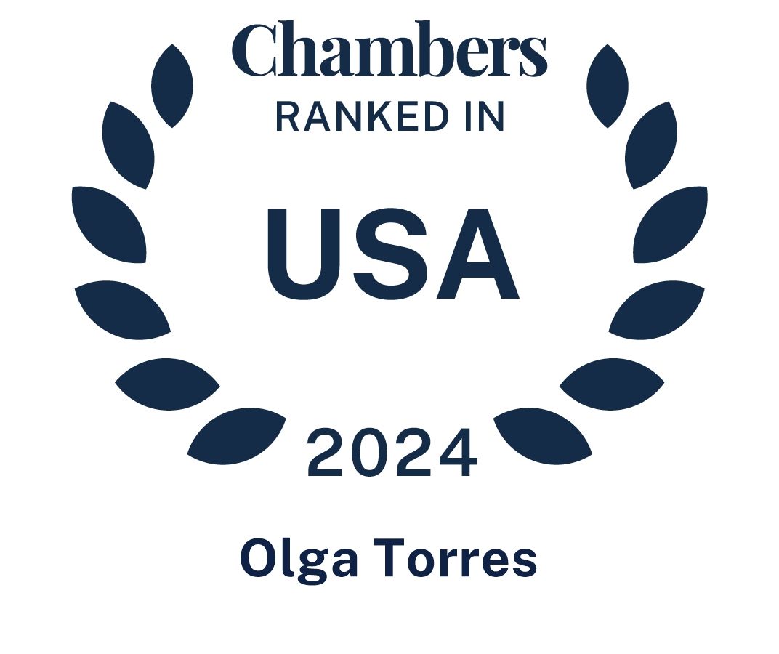






About Torres Trade Law
An International Trade & National Security Firm
At Torres Trade Law, we work with U.S. and international clients – from multinationals and Fortune 500 companies to medium-sized businesses and startups – to successfully import and export goods, technology, and services. We regularly assist clients navigate regulatory challenges posed by U.S. and foreign trade policies, including China tariffs, Iran and Russia sanctions, and the export of defense-related goods and controlled or emerging technologies.
In addition, we also have experience assisting clients with a wide range of foreign investment matters, including the Committee on Foreign Investment in the United States (CFIUS) administering the Foreign Investment Risk Review Modernization Act of 2018 (FIRRMA).

Slide 3
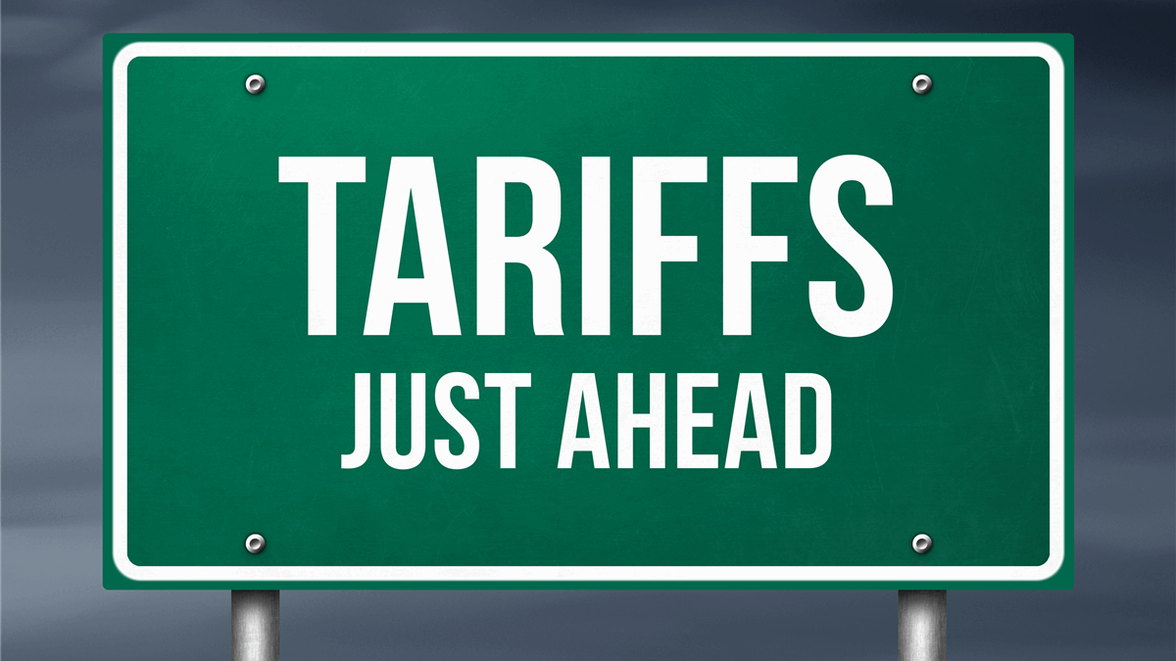


Agenda
Tariffs Background, Authorities, and Latest Updates
Legal Challenges
Enforcement
Issue Spotting and Compliance Strategies

Slide 4
Busy Year! Tariff Authority Overview
International Emergency Economic Powers Act (“IEEPA”)
“Reciprocal” tariffs
Fentanyl tariffs (Mexico, Canada, China)
Section 232 of the Trade Expansion Act of 1962
Sector-specific tariffs
Automobiles & auto parts, steel & aluminum, copper, timber & lumber
Section 301 of the Trade Act of 1974
7.5%- 100% tariff on wide-range of Chinese goods
Section 301 Investigation of Brazil
Brazil tariffs
Purchase of Russian Oil (India)

Slide 5
IEEPA Tariffs – Reciprocal
First announced on April 2, 2025 – “Liberation Day”
Apply to all imports of foreign-origin goods
Initial tariff rate of 10% for all countries
Executive Order Further Modifying Reciprocal Tariff Rates (July 31, 2025)
10% universal tariff on all countries and establishes other specific country rates on Annex I nations
I, DONALD J. TRUMP, President of the United States of America, find that underlying conditions, including a lack of reciprocity in our bilateral trade relationships, disparate tariff rates and non-tariff barriers, and U.S. trading partners’ economic policies that suppress domestic wages and consumption, as indicated by large and persistent annual U.S. goods trade deficits, constitute an unusual and extraordinary threat to the national security and economy of the United States. That threat has its source in whole or substantial part outside the United States in the domestic economic policies of key trading partners and structural imbalances in the global trading system. I hereby declare a national emergency with respect to this threat. (Excerpt from E.O. 14257)

Slide 6
IEEPA Tariffs – Fentanyl
First announced on February 1, 2025
Response to declared an emergency related to illicit drug trafficking (fentanyl) and organized crime- imposing tariffs due to Canada, Mexico, and China’s failure to assist with combatting related crime
Apply to imports of products originating from Canada, Mexico, and China
Canada- Increased from 25% to 35% tariff rate effective August 1, 2025
Mexico- Currently subject to 25% tariff rate. President Trump threatened to increase to 30%, but on July 31 announced that the increased tariffs would be paused for 90 days (via Truth Social post)
China- Currently subject to 20% tariff rate.
Do not apply to qualifying “originating” goods or content under the USMCA

Slide 7
Section 232 Tariffs
Based on “national security”
Administered by the Department of Commerce, Bureau of Industry and Security (BIS)
Multiple tariff actions targeting specific product groups have been implemented under Section 232
Steel & Aluminum (incl. derivatives) – 50% tariff
Automobiles & Automobile Parts – 25% tariff
Copper – 50% tariff
Timber & Lumber (incl. certain furniture)
10% on softwood lumber
25% on upholstered furniture (rising to 30% in 2026)
25% on kitchen cabinets and vanities (rising to 50% in 2026)
Beginning November 1: Medium/Heavy Duty Vehicles (25%) and Buses (10%)
Multiple Investigations in-progress (tariffs likely)
Semiconductors and Semiconductor Manufacturing Equipment; Pharmaceuticals; Critical Minerals; Commercial Aircraft and Jet Engines; Polysilicon; Unmanned Aircraft Systems (UAS); Wind Turbines; Robotics and Industrial Machinery; Personal Protective Equipment (PPE) and Medical Equipment

Slide 8

Section 301 Tariffs
Country Specific
Administered by the U.S. Trade Representative (USTR)
Tariffs on Chinese-origin goods from first Trump administration
Continued and expanded during Biden administration
Section 301 investigation of Brazil’s trade practices initiated on July 15
Section 301 tariffs stack with reciprocal and fentanyl tariffs

Slide 9
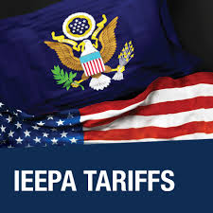
IEEPA Tariff Litigation
All IEEPA tariffs are currently in force, but IEEPA as a basis for tariffs is currently being litigated
V.O.S. Selections, Inc. v. Trump
May 28, 2025 – Court of International Trade (CIT) ruled that President Trump's tariff actions under IEEPA are unconstitutional; issues an injunction;
May 29, 2025 – Trump administration received relief from injunction, tariffs stay in place during course of litigation
August 30, 2025 – Court of Appeals for the Federal Circuit (CAFC) upheld the CIT’s decision, finding that the tariffs exceeded President’s authority under IEEPA.
November 5, 2025 – Supreme Court to hear oral arguments in consolidated case challenging IEEPA tariffs.
V.O.S. Selections, Inc. v. Trump
Learning Resources, Inc. v. Trump
Notes:
The CAFC compared language under IEEPA that does not specifically provide the President with authority to implement tariffs to language in other trade statutes (e.g., Trade Expansion Act of 1962, Trade Act of 1974, Trading with the Enemy Act (TWEA)) that has in the past explicitly provided Presidents with certain limited tariff authorities.
It is unclear if importers will be able to submit a claim to obtain refunds on IEEPA tariffs already paid
CAFC upheld the CIT opinion finding IEEPA tariffs not lawful (both fentanyl and reciprocal) but vacates "stay" on collection of tariffs. In other words, tariffs remain for the foreseeable future. (stay until mid-October to give federal gvmt time to appeal to supreme court)
However, multiple lawsuits are challenging the legality of Trump’s IEEPA-based tariffs (see details below). If the courts ultimately invalidate these tariffs importers may be eligible for refunds of tariffs paid —but potentially only if they preserve their rights through timely protests. Protests could also be filed to challenge the administration’s implementation of Section 232 tariffs (the legality of which was largely upheld during the first Trump administration).
Importers can file a protest within 180 days of liquidation relating to classification, value, duty treatment, and other issues, including situations where the importer was required by CBP to act in a certain fashion. To do this effectively, however, importers must monitor the dates their entries are liquidated in the Automated Commercial Environment.
Issues related to IEEPA and Section 232 tariffs that importers must watch for in their liquidations, and file timely protests to preserve their right to potential tariff refunds if necessary, include the following.
While favorable for importers, the decision will not immediately end the tariffs and is limited to only the reciprocal, fentanyl, and the actions removing de minimis. In other words, the Court’s ruling today does not directly apply to the Brazilian IEEPA tariffs or the Indian IEEPA tariffs and may not fully address the removal of de minimis, as that is not, technically, “tariffs” imposed by the Trafficking and Reciprocal emergencies.
Importantly, the CAFC has stayed its mandate, i.e., its remand to the CIT for reconsideration of the stay, until October, to give the parties time to file a request for the Supreme Court to review the case (a writ of certiorari). Therefore, we will likely not have clarity on the stay or refunds until the Supreme Court’s decision as we expect the Government will appeal.
If so, importers will be eligible for refunds equivalent to the duties paid for fentanyl & reciprocal tariffs retroactive to the first day of application
Entries may not be corrected using a post summary correction (PSC) or filed without the IEEPA tariffs until a final determination is made
If entries liquidate, importers will need to file a protest to protect those entries and ensure they remain open (pending litigation)
In the meantime, track your entries!
Even if this case doesn’t go like Trump wants, GVMT still has Section 232, Section 301, and others such as:
Section 122 – which may impose tariffs in response to “fundamental international payment problems” but it is a lot more limited i.e., as much as 15% for up to 150 days
Section 338- may impose tariffs of up to 50% on countries’ imports if he believes they are engaging in trade practices that discriminate against the U.S.

Slide 10
IEEPA Tariff Litigation - SCOTUS
Challengers’ arguments –
Text of IEEPA does not reference duties, tariffs, or any other revenue-raising mechanism
Congress has not historically delegated taxing authority to the President via the term “regulate”
Even if IEEPA does grant power to impose tariffs, this power is not unlimited and does not uphold the President’ implementation of broad trafficking and reciprocal tariffs
“Major Questions Doctrine” – the power to implement tariffs has “vast economic and political significance” and Congress must have been clear in delegating this power
Government’s arguments –
The power to “regulate” imports includes the power to impose tariffs
The power to “prohibit” imports would include the “lesser” power to regulate imports through the imposition of tariffs
Trading with the Enemy Act (TWEA), predecessor to IEEPA, provided power to “regulate importation” which was used by President Nixon to impose a 10% global tariff
The “Major Questions Doctrine” is not applicable in this scenario because of the foreign policy and national security implications of the tariffs
In the event of a declared national emergency, IEEPA grants the President authority to “regulate” or “prohibit” imports.
50 U.S.C. §1702

Slide 11

CBP Enforcement
The volatile tariff environment has led to increased scrutiny and enforcement of U.S. import laws by Customs and Border Protection (CBP)
Customs violations can lead to investigations by CBP, administrative enforcement actions, fines, and penalties.
Increase in issuances of CF-28 Requests for Information and CF-29 Notices of Proposed or Taken Action

Slide 12
DOJ Enforcement of Customs Violations
Criminal enforcement of customs and trade violations, particularly tariff evasion, is a priority under the Trump administration
DOJ Criminal Division Memorandum published on May 12, 2025
Key priority enforcement areas include illicit activity implicating U.S. national security, financial crimes facilitated by cartels and transnational criminal organizations, violations of U.S. trade and customs laws, including evasion of import tariffs
Two main statutory vehicles for customs-related enforcement –
19 U.S.C. 1592
Federal False Claims Act (“FCA”)
Expect to see continuation of trend of prosecutions of import violations under the federal False Claims Act

Slide 13
Red Flags/Issue Spotting
If seller/supplier provides solution that seems “too good to be true,” it likely is!
Has the HTS code, country of origin, or valuation methodology changed recently (or after tariffs in first Trump administration)?
HTS code change requires solid evidence and review.
To prevent “transshipment,” ensure substantial transformation applies.
Product valuation must meet specific methodologies, usually “transfer price.”
Does the importer have an import compliance program?
Importers should not unreasonably rely on third parties such as customs brokers; use reasonable care.
USMCA applies when valid; conduct the analysis!
M&A Due Diligence: Ask about import activity

Slide 14
Compliance Tips & Strategic Mitigation
Track Federal Register publications, official CBP guidance, White House Press Office, and – seriously – President Trump’s Truth Social account and other social media (a lot is happening and quickly!)
Update Manuals and Internal Procedures, incl. training
Communicate with and monitor customs brokers
HTS code reviews (some HTS codes excepted from certain tariffs)
Consider requesting a binding ruling from CBP
Foreign trade zones
First sale program
Duty Drawback (not available for fentanyl IEEPA or Section 232, but available for reciprocal tariffs and Section 301)
If violations discovered, consider prior disclosure to CBP to mitigate penalties.

Slide 15


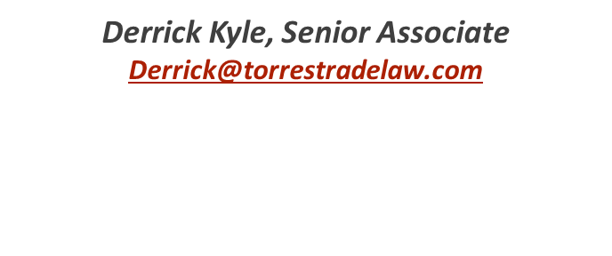
Let’s Be Friends
Camille Edwards, Associate
Camille@torrestradelaw.com
1201 Main St., Suite 1350, Dallas, Texas
214.295.8473
1717 K St. NW, Suite 900, Washington DC
202.851.8200
(By appointment only)

Slide 16
Resources
Torres Trade Trump Table – Keep track of all trade-related actions under the second Trump administration including new executive orders, agency rules and determinations, sanctions & export controls, tariff updates, and key litigation.
Global Tariff Navigator– Country-specific tariff rates provided all in once place, with up-to-date rates, notes on potential future country-specific actions to be aware of, and effective dates for tariff actions.
Torres Trade Law Newsletter – periodic news on topics related to international trade, national security, foreign investment, legal updates, and compliance practices.

