Slide 1
The Changing Texas Business Landscape

Slide 2
Texas Legislative Process

Slide 3
The Texas Legislative Process
The Texas Legislature meets for 140 days every odd numbered year
Governor can call special sessions that last up to 30 days
Only constitutionally required to pass a balanced budget
Interim Charges are issued by each chamber during the interim year
150 members in the House of Representatives - led by a peer-elected Speaker of the House
31 members in the Senate – led by a statewide elected Lieutenant Governor

Slide 4
89th Session Dates & Bill Statistics
Dates
First Day of Session: January 14, 2025
Last Day of Session (Sine Die): June 2, 2025
Bill Statistics
Bills Filed: 8,719
Bills that Failed to Pass: 7,506
Bills that Became Law: 1,185
Bills Vetoed: 28
Joint Resolutions Filed: 295
Joint Resolutions Filed w/ Secretary of State: 17

Slide 5
Texas Business Landscape

Slide 6
Texas Business Landscape
Texas’ $2.7 trillion economy is the eighth largest in the world (U.S. Bureau of Economic Analysis, 2024; Texas Economic Development Corporation).
Today, one in 10 public companies in the U.S. (Texas Economic Development & Tourism Office, 2025) and more than 50 Fortune 500 companies (Texas Economic Development Corporation, 2023) are headquartered in Texas.
Between 2020 and June 2025, 201 companies moved their headquarters to Texas (Build Remote, 2024), including Charles Schwab, which relocated its San Francisco headquarters to Westlake, Texas (NBC Dallas-Fort-Worth, 2020). In addition, many companies expanded their operations in Texas during the same period, including:
Goldman Sachs, which added 5,000 Texas-based employees (Goldman Sachs, 2023);
Fidelity Investments, which added 2,000 jobs in Texas (Fort Worth Business Press, 2021);
Wells Fargo, which invested in an 850,000-square-foot campus to house thousands of employees in Texas (Dallas Morning News, 2023); and
JPMorgan Chase, which built a 6,500-person campus in Plano, Texas, and which now has more employees in Texas than in New York state (New York Post, 2023).
As a result, in 2023, for the first time in over 33 years, Texas surpassed the state of New York in the number of workers employed in finance and banking (Yahoo Finance, 2024), and as of November 2024, Texas employed nearly 192,000 more workers in financial activities than the state of New York (Bureau of Labor Statistics, 2024).

Slide 7
Texas Business Landscape
Texas is proudly pro-business, with sensible regulation, robust infrastructure, a diverse and highly skilled workforce, and no corporate or personal income tax (Texas Economic Development & Tourism Office, 2023), and, as such, ranked #1 for Best Business Climate in Business Facilities’ 2024 State Rankings (Business Facilities: The Source for Site Selectors, 2024).
However, as Governor Abbott mentioned, “There is a difference between becoming a champion and repeating as a national champion year after year. To remain at the highest level requires constant innovation and improvement, and that is what we constantly work at to keep Texas as the best business climate in America” (Office of the Texas Governor, 2025).
In keeping with this sentiment, since 2023, the Texas legislature has adopted sweeping amendments to the Texas Business Organizations Code (the “TBOC”) designed make Texas a more attractive destination for businesses, including:
88(R) H.B. 19, which created the Texas Business Court;
89(R) S.B. 29, which reforms derivative litigation and enhances liability protections for managerial officials;
89(R) S.B. 1057, which allows publicly traded corporations to impose thresholds for shareholder proposals;
89(R) S.B. 2411, which streamlines approval of certain fundamental business transactions; and
89(R) S.B. 2337, which imposes certain disclosure obligations on proxy advisors.

Slide 8
Texas Business Landscape
Texas legislators also have supported establishment of the Texas Stock Exchange (“TXSE”), including U.S. Senator John Cornyn, who sent a letter to the U.S. Securities and Exchange Commission (“SEC”), stating:
Competition is the foundation of America's capital markets. Unfortunately, the number of publicly traded companies have significantly declined over the past 25 years, limiting public investment opportunities and decreasing competition. Establishing a new exchange will give issuers more options to drive innovation and improve capital formation. If approved, the TXSE will bolster competition in all areas of the exchange business, including listings, trading technology, market structure, market data, and market connectivity (Senator Cornyn’s office, 2025).

Slide 9
Texas Stock Exchange

Slide 10
Texas Stock Exchange
TXSE is the first fully integrated national securities exchange to receive SEC approval in decades and, with $250 million of capital following its second funding round, the most well-capitalized equities exchange ever approved by the SEC.
Its founding investors include the world’s largest financial institutions, including most major liquidity providers, leading corporate executives from across the country, and prominent retail and institutional investment organizations.
Subject to SEC approval, TXSE will be a national, fully integrated, and fully electronic exchange offering trading, listings of corporate issuers and exchange-traded products (“ETPs”), auctions, and a range of data products. TXSE intends to serve U.S.-based and international issuers, investors, and market participants.

Slide 11
Texas Stock Exchange
The number of publicly traded companies has fallen by almost 45% in the past 25 years, and today, there are fewer public companies in the U.S. than ever before (World Bank, 2025). The regulatory costs of listing and satisfying audit, legal, and financial requirements may partially explain why companies have elected to stay private and why publicly traded companies have elected to delist, go private, or merge with other companies (Meketa Investment Group, 2024).
The declining number of publicly traded companies has created a shortage of investments opportunities for investment organizations and possibly has contributed to retail investors’ inability to participate in IPOs.
In addition, the burden of going and staying public arguably has prevented certain companies (like mid-sized and emerging growth companies) from accessing public markets, possibly reducing innovation, job creation, and economic growth.

Slide 12
Texas Stock Exchange
TXSE aims to reverse the decades-long decline in the number of U.S. public companies by reducing the burden of going and staying public while maintaining some of the highest quantitative standards in the industry. TXSE’s goals are:
addressing high cost of going and staying public
By leveraging advanced technology and a lean operational model, TXSE aims to offer lower listing and trading fees compared to competing exchanges, making public markets more accessible to a broader range of companies.
TXSE has completed its proprietary order matching engine and exchange platform, incorporating the latest hardware and software to deliver flexibility, low-latency performance, scalability in an evolving trading and regulatory environment, and speed comparable to that of the world’s top-performing markets.
TXSE may provide more straightforward and less burdensome listing requirements beyond those mandated by the SEC, including reduced reporting obligations, fewer mandatory disclosures, and greater flexibility in corporate governance structures.
restoring competition for issuers in America’s public markets
TXSE aims to introduce competition to U.S. capital markets, offering an alternative to the New York Stock Exchange (NYSE) and NASDAQ. This competition may drive down listing fees, improve service quality, and foster innovation in trading technology and market structure.

Slide 13
Texas Stock Exchange
providing comprehensive listing solutions for corporate issuers and ETP sponsors that are fully transparent and aligned with their priorities
Jamie Dimon, Chairman and Chief Executive Officer of JPMorganChase, has highlighted the following factors as contributing to companies’ decisions to remain private: (i) pressure for quarterly earnings updates, which may distort long-term planning and goals in favor of producing stable short-term numbers to support the share price, (ii) issue-specific interest groups “hijacking” annual shareholder meetings rather than discussing company fundamentals and prospects, and (iii) proxy-voting advisors with undue influence that apply cookie-cutter governance rules regardless of company context, qualifications, talent, or situations (JPMorganChase, 2024).
To combat these pressures and to align Texas law with issuers’ priorities, TXSE successfully championed the passage of the 2025 Texas Capital Markets Package, which included 89(R) S.B. 1057, which allows publicly traded corporations to impose thresholds for shareholder proposals, and (ii) 89(R) S.B. 2337, which imposes certain disclosure obligations on proxy advisors.
establishing the premier venue for listings and creating a world-class trading platform for all market participants

Slide 14
Texas Stock Exchange
As mentioned above, TXSE already has differentiated itself from other securities exchanges by spearheading key legislative and legal reforms to strengthen Texas’ pro-business environment and to establish Texas as the premier jurisdiction for corporate headquarters, listings, and exchange operators. Another key measure of the 2025 Texas Capital Markets Package is Texas House Joint Resolution 4 (“HJR 4”), which was passed by the Texas legislature in the 2025 session and approved by Texas voters on November 4, 2025. HJR 4 prohibits the Texas legislature from enacting taxes on securities transactions and occupation taxes on registered securities market operators.
In 2021, Stacey Cunningham, the head of the NYSE, penned an op-ed in the Wall Street Journal publicly warning that the exchange could move to Texas if New York instituted a financial transaction tax (Wall Street Journal, 2021).
Both New Jersey and New York have weighed levying a financial transaction tax on stock transfers (Tax Foundation, 2020).

Slide 15
Texas Stock Exchange
Further, TXSE and the Texas Association of Business (“TAB”) jointly intervened as defendants in Institutional Shareholder Services Inc.’s and Glass, Lewis & Co., LLC’s lawsuits challenging S.B. 2337, arguing that (i) they have a private right of action under SB 2337, (ii) they have direct and protectable interests at stake, given their representation of Texas companies (which have an interest in limiting “misleading proxy advice”), and (3) their interests diverge from those of the Texas attorney general, who may not need to defend the law on the merits (ISS docket; Glass Lewis docket). Glenn Hamer, TAB President & CEO, issued the following statement:
For shareholders, the bottom line should always be the bottom line, not politically motivated activist recommendations that are not based on financial analyses and, in some cases, may be against shareholders’ best financial interests – including explicitly advising companies against re-incorporating in Texas. Moreover, the virtual duopoly of the proxy advisory industry has effectively crowded out competition, leaving these critical decisions in the hands of very few and undermining transparency in the process (Texas Association of Business, 2025).

Slide 16
Texas Business Court

Slide 17
Texas Business Court
OVERVIEW: | Texas Business Court is a statewide trial court created to resolve certain complex business disputes, which is presided over by judges with experience in complex commercial matters. See Tex. Gov’t Code § 25A enacted by 88(R) H.B. 19 (2023).
JUDGES: | Texas Governor, with advice and consent of Senate, appoints judges for 2-year terms; judges may serve multiple terms. Judges must have at least 10 years of experience in business transaction law, complex civil business litigation, and/or serving as a judge in a Texas court with civil jurisdiction.
JURISDICTION: | The Business Court has jurisdiction over certain specific categories of commercial cases, where the amount in controversy exceeds $5 million (except in cases involving publicly traded companies), such as securities litigation, derivative proceedings, breaches of fiduciary duties, corporate governance and internal corporate affairs issues, actions arising out of the Texas Business Organizations Code, and commercial transactions in which the parties agree the Business Court has jurisdiction.
PROCEDURES: | Same rules and procedures as district courts, except that filing fees are higher (compare $350 district court filing fee to $2,500 Business Court filing fee) and that Business Court must provide a written opinion for dispositive ruling upon request of any party.
APPEALS: | Newly created Fifteenth Court of Appeals—based in Austin—has direct appellate review of Business Court decisions, and decisions of Fifteenth Court of Appeals are subject to discretionary appellate review by Supreme Court of Texas.
BENEFITS: | Business Court creates specialized forum to resolve complex commercial disputes in a more predictable manner. Cases in both Business Court and District Courts should be resolved more quickly due to Business Court’s limited jurisdiction and District Courts’ caseload being reduced by removing some commercial disputes to Business Court. Business Court’s written opinions will provide additional guidance regarding commercial issues under Texas law.

Slide 18
Legislative Updates

Slide 19
Managerial Official Litigation Protections
Topic | Applicability | Notes
Codified Business Judgment Rule (TBOC §§ 21.419, 101.256 and 153.163 enacted by S.B. 29) | Corporations, limited partnerships, and limited liability companies that (1) are publicly traded or (2) elect to be governed by codified business judgment rule in their certificates of formation or bylaws, in the case of corporations, company agreements, in the case of limited liability companies, or partnership agreements, in the case of limited partnerships. | No domestic entity or any of its equityholders will have a claim against any managerial official for any act or omission in their official capacity, unless the claimant can (1) refute assumptions that the managerial official acted in good faith, in accordance with applicable law and the entity’s governing documents, and, for corporations only, on an informed basis and in the entity’s best interests, and (2) prove (a) breach of duty and (b) fraud, intentional misconduct, ultra vires acts, or knowing violations of law in breaching that duty.
Exculpation of Corporate Officers for Violation of Duty of Care (TBOC § 7.001 as amended by S.B. 2411) | Corporations | Exculpation must be in certificate of formation.
Elimination of Fiduciary Duties of Managerial Officials of Partnerships and Limited Liability Companies (including Obligation of Good Faith) (TBOC §§ 101.401 and 152.002(e) as amended by S.B. 29) | Limited Partnerships; Limited Liability Companies | Elimination must be set forth in partnership agreement or limited liability company agreement, as applicable.

Slide 20
Forum, Jury Trial Waiver, and Exclusions from Books and Records Requests
Topic | Applicability | Notes
Exclusive Venue in Texas Courts for Internal Entity Claims (TBOC § 2.115(b) as amended by S.B. 29) | Domestic entities that specify in their governing documents that one or more Texas courts will serve as the exclusive venue for internal entity claims | “internal entity claims” mean claims based on, arising from, or relating to an entity’s internal affairs, including derivative claims.
Bench Trial for Internal Entity Claims (TBOC § 2.116 enacted by S.B. 29) | Domestic entities that waive in their governing documents the right to trial by jury concerning internal entity claims | TBOC Section 2.116(c) specifies that waiver is enforceable regardless of whether applicable governing document is signed by the members, owners, officers, or governing persons. TBOC Section 2.116(d) states that person asserting an internal entity claim “knowingly waived” right to trial by jury if the person: (1) voted for or affirmatively ratified the governing document containing the waiver or (2) acquired or continued to hold an equity security of the domestic entity following adoption of the waiver. Constitutional challenges possible.
Emails, Texts, and Social Media Communications Excluded from Books and Records Requests (unless they effect action by relevant domestic entity) (TBOC §§ 21.218(b), 101.502(a) and 153.552(a) as amended by S.B. 29) | Corporations; Limited Partnerships; Limited Liability Companies

Slide 21
Derivative Litigation Reform
Topic | Applicability | Notes
Ownership Threshold to Initiate Derivative Proceedings (TBOC § 21.552(a) as amended by S.B. 29) | Publicly traded corporations Privately held corporations with 500 or more shareholders (when proceeding is initiated) that have elected to be governed by codified business judgment rule | Corporations must specify in their governing documents a minimum ownership percentage to initiate derivative litigation (not to exceed 3% of outstanding shares).
No Books and Records Inspection Rights in Derivative Litigation or Civil Lawsuits (TBOC § 21.218(b) as amended by S.B. 29) | Publicly traded corporations Privately held corporations that have elected to be governed by codified business judgment rule | Does not impair right to obtain discovery of records from the corporation in a civil lawsuit or derivative proceeding
No Attorneys’ Fees in Disclosure-Only Settlements (TBOC §§ 21.561(c), 101.461(c) and 153.411(c) enacted by S.B. 29) | Corporations; Limited Partnerships; Limited Liability Companies
Novel Mechanism to Predetermine Director Independence (TBOC §§ 21.4161 and 21.554 enacted by S.B. 29) | Publicly traded corporations Privately held corporations that have elected to be governed by codified business judgment rule | Applies to committees established to evaluate: transactions with a director, officer, or controlling shareholder; and how to proceed regarding allegations asserted in derivative proceedings. Court’s finding is “dispositive” absent facts, not presented to the court, constituting evidence sufficient to prove a director is not independent and disinterested.

Slide 22
Limitations on Shareholder Proposals; Proxy Advisor Disclosures
Topic | Applicability | Notes
Ownership Thresholds for Shareholder Proposals (TBOC § 21.373 enacted by S.B. 1057) | Publicly traded companies, with equity securities registered under Securities Exchange Act, that are headquartered in Texas or listed on a Texas stock exchange and that elect in their governing documents to be governed by TBOC § 21.373. | Shareholder(s) must hold voting shares equal to at least $1 million in market value or 3% of corporation’s voting shares for at least six months before meeting date. Shareholder(s) must solicit holders of at least 67% of the voting power of shares entitled to vote on proposal. Inapplicable to director nominations and procedural resolutions ancillary to conduct of meeting. Exceeds Rule 14a-8 of the Securities Exchange Act of 1934, which has no analogous solicitation requirement and an ownership threshold of $25,000, $15,000 or $2,000 in market value (based on holding period of one, two and three years, respectively).
Proxy Advisor Disclosures (TBOC §§ 6A.001 – 6A.202 enacted by S.B. No. 2337) | Publicly traded partnerships, for-profit corporations, limited liability companies, and other business entities that are organized, headquartered, or considering redomiciling in Texas | Disclosures required if proxy advisor’s advice “is not provided solely in the financial interest of the shareholders of a company” or if proxy advisor provides “materially different” recommendations (including recommendations against management’s recommended voting)

Slide 23
Transactional Updates
Topic | Applicability | Notes
Approving Fundamental Business Transactions (TBOC § 21.365(b) as amended by S.B. 29) | Corporations | Before S.B. 29, separate approval of each class and series was required for fundamental actions and fundamental business transactions. Texas corporations may now waive class-by-class voting in their certificates of formation for any matter, including fundamental business transactions.
Streamlined Approval of Mergers, Major Transactions and Related Actions (TBOC §§ 3.106, 10.004 and 10.104 enacted by S.B. 2411) | Publicly traded corporations Privately held corporations that have elected to be governed by codified business judgment rule | Documents may be approved in “substantially final form”; disclosure schedules not part of plan of merger. Shareholder Representatives Plan of conversion can authorize additional actions by converted entity without additional approvals by governing authority.
Preclearance and Same-Day, Next-Day, and Standard Expedited Processing | Certificate of Conversion Certificate of Merger Certificate of Amendment (domestic entities) Restated Certificate of Formation (domestic entities) Certificate of Validation (domestic corporations) | Same-day and next-day transaction must be filed in person by 12 p.m. Standard expedited processing typically is 2 to 3 business days.

Slide 24
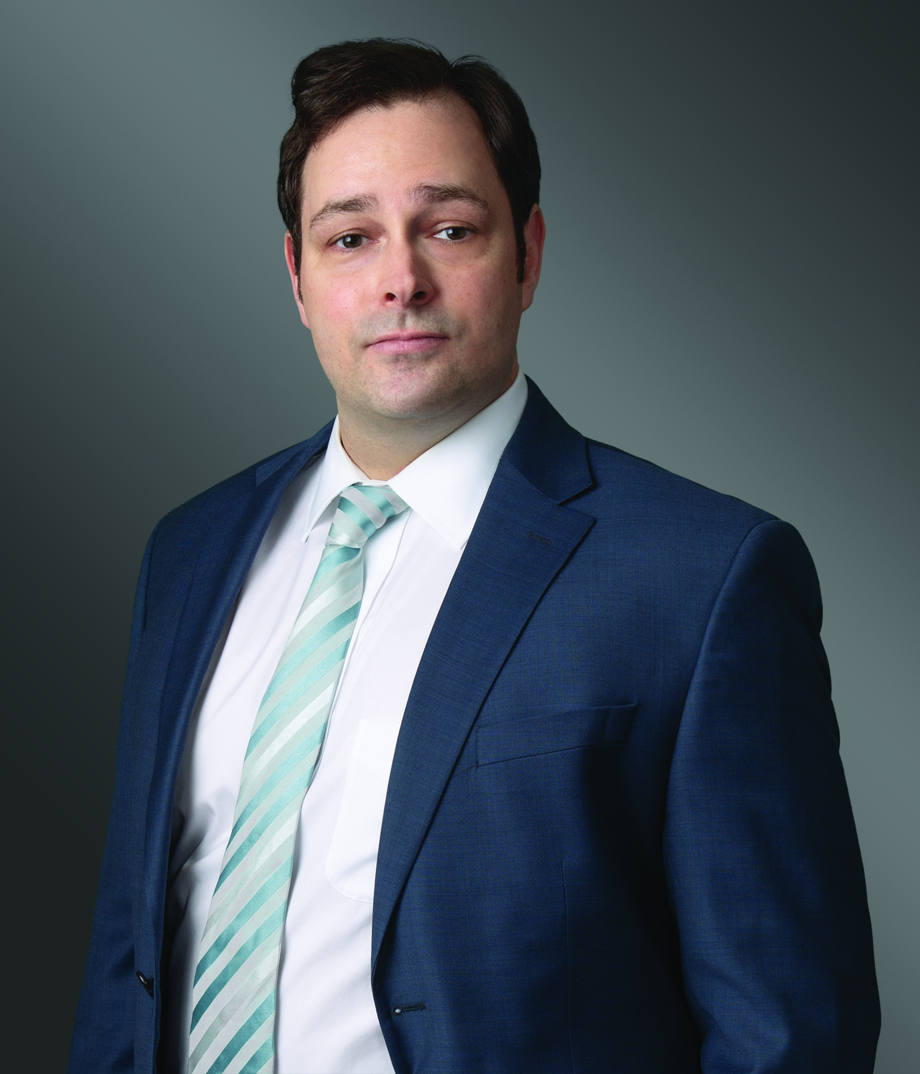
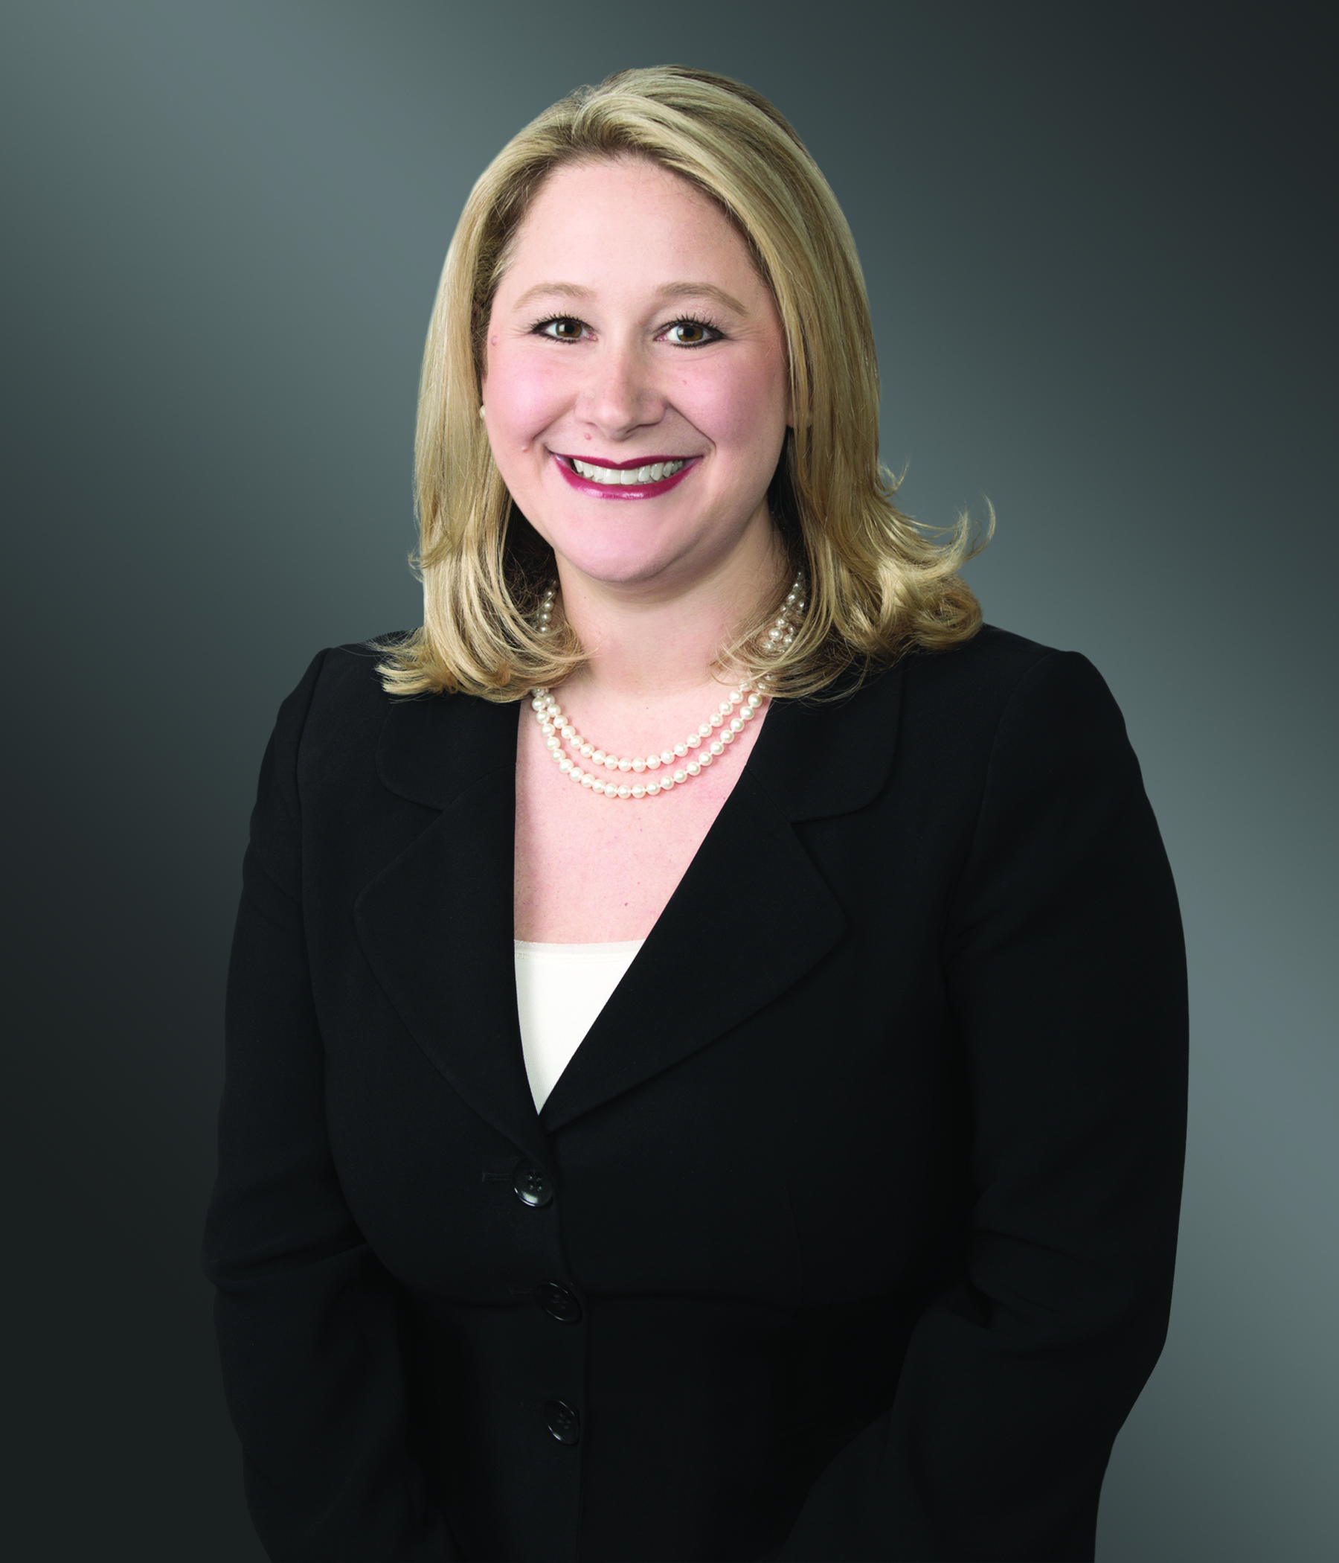
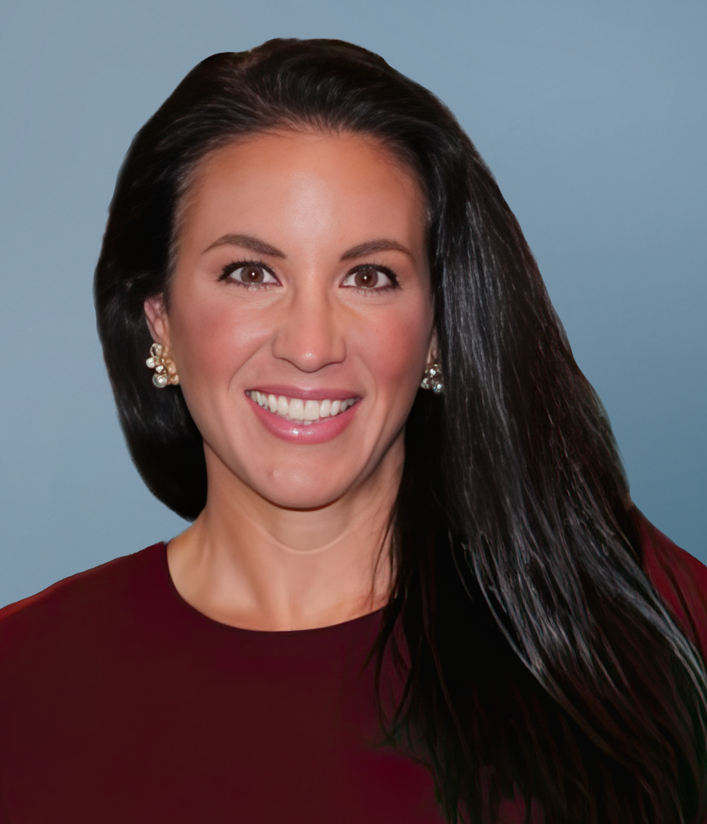
Contact Us
John Holland
Shareholder
Greenberg Traurig, LLP
hollandj@gtlaw.com
Elizabeth Hadley
Shareholder
Greenberg Traurig, LLP
elizabeth.hadley@gtlaw.com
Nicole Chambers
Global Managing Director of Listings
Texas Stock Exchange
nicole.chambers@txse.com

