Slide 1
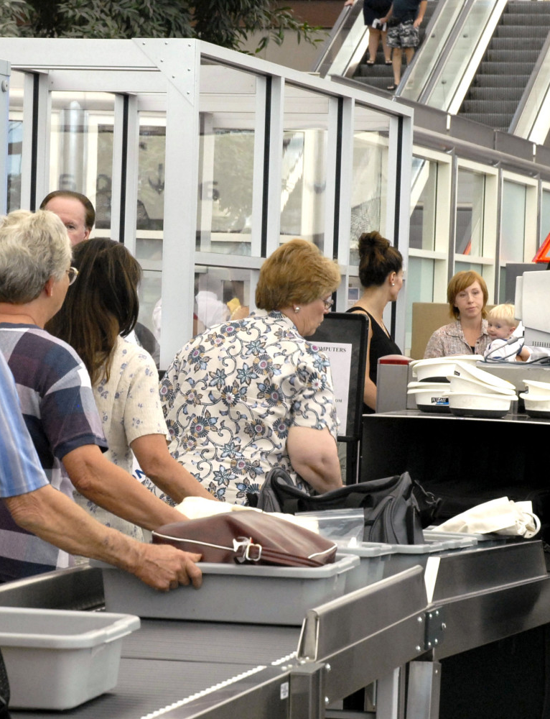

Global Immobility
Summary of Current U.S. Travel Ban and ESTA Change Implications for Affected Foreign Nationals
January 22, 2026 12 to 12:30 CST
PRESENTED BY:
Kathleen Campbell Walker, ILS Chair and Chair of Dickinson Wright Pllc Immigration Practice Group (El Paso/Denver)
Avalyn C. Langemeier, Partner, Foster LLP (Houston)
This Photo by Unknown Author is licensed under CC BY-NC-ND

Slide 2
Visa, Passport, Admission, I-94, Lawful Status, Validity Period, Out of Status, Unlawful Presence, Nonimmigrant, Immigrant
TERMS

Slide 3
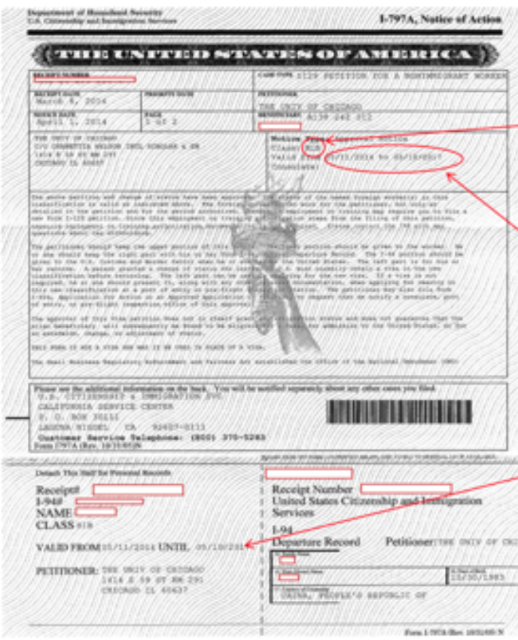
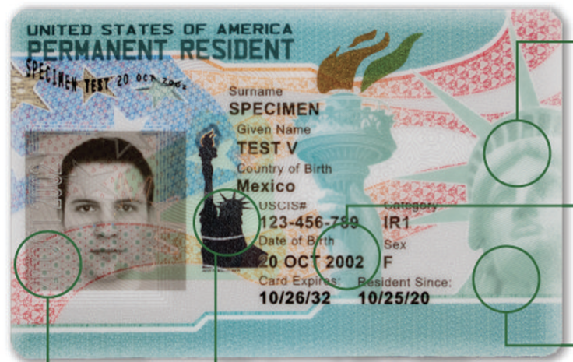
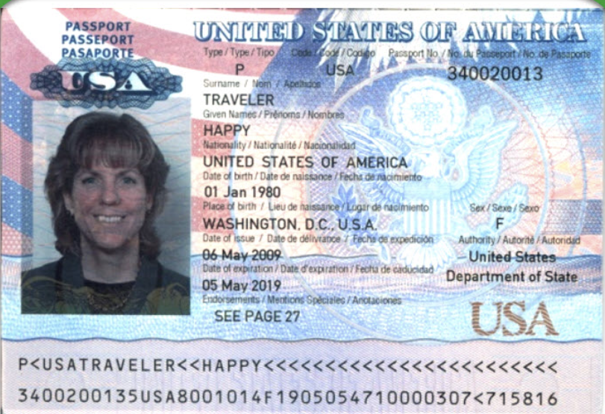
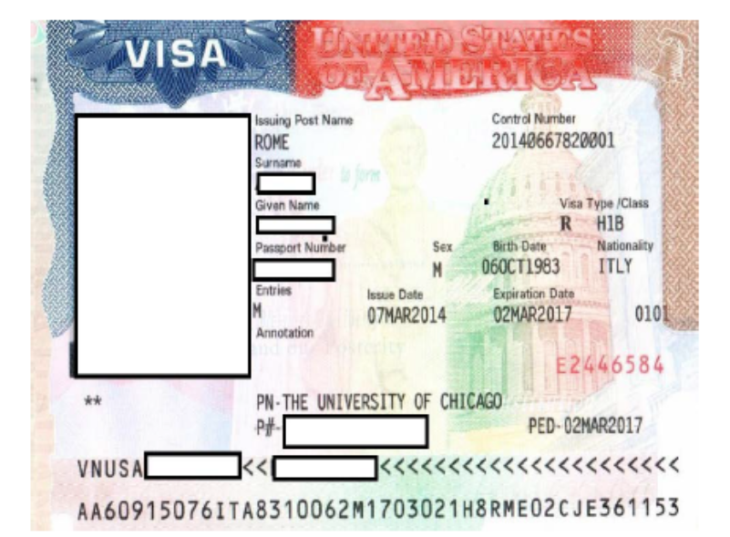

Slide 4








IMMIGRATION INTERAGENCY COOPERATION
Admission
Consular
ADJUDICATiONS/BenefitS
Enforcement

Slide 5
TRAVEL BANS
I. Proclamation 10949 - June 4, 2025 (effective 12:01 am Eastern standard daylight time on June 9, 2025) 90 Fed. Reg.24497 (6/10/25)
RESTRICTING THE ENTRY OF FOREIGN NATIONALS TO PROTECT THE UNITED STATES FROM FOREIGN TERRORISTS AND OTHER NATIONAL SECURITY AND PUBLIC SAFETY THREATS
https://www.whitehouse.gov/presidential-actions/2025/06/restricting-the-entry-of-foreign-nationals-to-protect-the-united-states-from-foreign-terrorists-and-other-national-security-and-public-safety-threats/
II. Proclamation 10998 - December 16, 2026 (effective 12:01 a.m. Eastern standard time on January 1, 2026) 90 Fed. Reg. 59717 (12/19/25)
RESTRICTING AND LIMITING THE ENTRY OF FOREIGN NATIONALS TO PROTECT THE SECURITY OF THE UNITED STATES
https://www.whitehouse.gov/presidential-actions/2025/12/restricting-and-limiting-the-entry-of-foreign-nationals-to-protect-the-security-of-the-united-states/

Slide 6
TRAVEL BAN SCOPE
ONE (Proclamation 10949 effective 12:01 am EST June 9, 2025):
The suspensions of and limitations on entry pursuant to sections 2 and 3 of this proclamation shall apply only to foreign nationals of the designated countries who:
(i) are outside the United States on the applicable effective date of this proclamation; and
(ii) do not have a valid visa on the applicable effective date of this proclamation.
Visa applicants who are subject to this Presidential Proclamation may still submit visa applications and schedule interviews, but they may be ineligible for visa issuance or admission to the United States.
TWO (Proclamation 10998 effective 12:01 a.m. EST Jan.1, 2026):
The suspensions of and limitations on entry pursuant to sections 2, 3, 4, and 5 of this proclamation shall apply only to foreign nationals of the designated countries who:
(i) are outside the United States on the applicable effective date of this proclamation; and
(ii) do not have a valid visa on the applicable effective date of this proclamation.

Slide 7
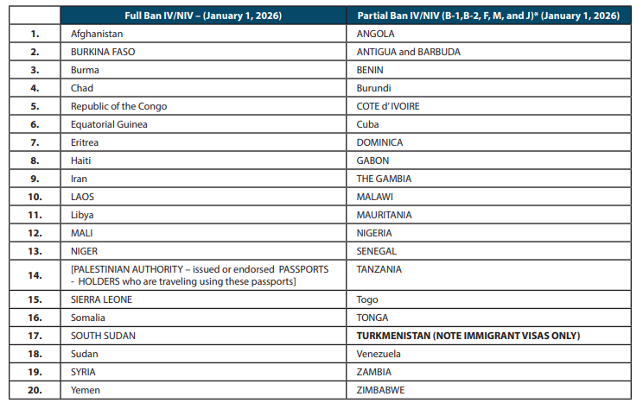
TRAVEL BAN AS OF JAN. 1, 2026 See DOS website, Suspension of Visa Issuance to Foreign Nationals to Protect the Security of the United States, last updated Dec. 19, 2026

Slide 8
TRAVEL BAN EXEMPTIONS (1/1/26)
1. U.S. Lawful Permanent Residents. Note: A holder of an immigrant visa is not a lawful permanent resident until admitted to the U.S. using their immigrant visa.
2. Dual Nationals traveling to the U.S. on the passport of a country not subject to the Proclamation.
3. Nonimmigrants traveling to the U.S. with a valid nonimmigrant visa in these categories: A-1, A-2, C-2, C-3, G-1, G-2, G-3, G-4, NATO-1, NATO‑2, NATO-3, NATO-4, NATO-5, or NATO-6.
4. Athletes or members of an athletic team, including coaches, persons performing a necessary support role, and “immediate relatives” (e.g. spouse, parent, minor children?) traveling for the World Cup, Olympics, or other major sporting event as determined by the Secretary of State. (e.g., the 2026 FIFA World Cup).
FIFA Priority Appointment Scheduling System (PASS) announced by the Department of State (DOS) on November 17, 2025 https://www.state.gov/fifa-world-cup-26-visas and https://inside.fifa.com/organisation/media-releases/world-cup-2026-ticket-holders-prioritised-visa-appointments-united-states .
5. Special Immigrant Visas for U.S. Government employees.
6. Immigrant visas for ethnic and religious minorities facing persecution in Iran.
REMOVED -
Immediate family immigrant visa holders (i.e., IR-1/CR-1, IR-2/CR-2, IR-5) with clear and convincing evidence of identity and family relationship (e.g., DNA). (REMOVED UNDER DECEMBER PROCLAMATION EFFECTIVE 1/1/26)
Adopted children (i.e., IR-3, IR-4, IH-3, IH-4). (REMOVED UNDER DECEMBER PROCLAMATION EFFECTIVE 1/1/26)
Afghan Special Immigrant Visas. (REMOVED UNDER DECEMBER PROCLAMATION EFFECTIVE 1/1/26)

Slide 9
TRAVEL BAN EXCEPTIONS (1/1/26)
1. Foreign nationals whose travel to the U.S. is found by the Attorney General to advance a critical U.S. national interest involving the Department of Justice (DOJ), including being present in the U.S. to participate as a witness in criminal proceedings. The Attorney General, or her designee, shall make these determinations in coordination with the Secretaries of DHS and State.
2. Foreign nationals whose travel to the U.S. is determined on a case-by-case basis by the Secretary of State to serve the national interest of the U.S. The Secretary of State, or his designee, shall make these determinations in coordination with the Secretary of DHS or her designee
3. Foreign nationals whose travel to the U.S. is determined on a case-by-case basis by the Secretary of Homeland Security to serve the national interest of the U.S. The Secretary of Homeland Security, or her designee, shall make these determinations in coordination with the Secretary of State or his designee.

Slide 10
Electronic System for Travel Authorization (ESTA) – Comments due 2/9/2026 90 Fed. Reg 57208 https://esta.cbp.dhs.gov/
1. Move ESTA Website to ESTA MOBILE APP
2. Biometric Confirmation of Exit using Geolocation and Liveness Detection of Selfie
3. Selfie Upload in addition to Photo of Passport Bio Page
4. Removal of Romania and addition of Qatar
5. Social Media for last 5 years to be added
6. High Value Data Fields Expanded
a . Telephone numbers used in the last five years;
b. Email addresses used in the last ten years;
c. IP addresses and metadata from electronically submitted photos;
d. Family member names (parents, spouse, siblings, children);
e. Family number telephone numbers used in the last five years;
f. Family member dates of birth;
g. Family member places of birth;
h. Family member residencies;
i. Biometrics—face, fingerprint, DNA, and iris;
j. Business telephone numbers used in the last five years; and
k. Business email addresses used in the last ten years.
OMB Control Number 1651-0111

Slide 11
USCIS PAUSES (HOLDS ON ADJUDICATION)
USCIS Policy Memo, January 1, 2026 (PM-602-0194),
“Hold and Review of All Pending Asylum Applications and All USCIS Benefits Filed by Aliens from High Risk Countries.”
1. Place a hold on all USCIS “pending applications” (benefit requests) for “aliens” listed in Proclamation 10998 pending a comprehensive review regardless of entry date. (Expands the hold from USCIS Policy Memo PM-602-0192, Dec. 2, 2025, to track the second travel ban notice adding 39 countries.)
2. Conduct a comprehensive review of all policies, procedures, and screening and vetting processes for benefit requests for aliens for aliens listed in PP 10998.
3. Conduct a comprehensive re-review of benefit requests implicated in PP10998 that were approved on or after January 20, 2021.
Prior USCIS Policy Memo PM-602-0192, Dec. 2, 2025, said pause does not apply to USCIS screening activities, including credible fear, reasonable fear, safe third country, third country removal, and threshold screenings under the Asylum Cooperative Agreements. The prior PM also did not track the Proclamation’s exception for dual nationals entering the U.S. using a passport from a non-travel ban country.

Slide 12
DOS Dept. Of State Immigrant Visa Pause 75 Countries
26 STATE 3740 Jan 14. 2026
Pausing Immigrant Visa Issuances for Nationalities at High Risk of Public Charge
Effective January 21, 2026

Slide 13
The Seventy-Five Countries
Afghanistan, Albania, Algeria, Antigua and Barbuda, Armenia, Azerbaijan, Bahamas, Bangladesh, Barbados, Belarus, Belize, Bhutan, Bosnia, Brazil, Burma, Cambodia, Cameroon, Cape Verde, Colombia, Cote d’Ivoire, Cuba, Democratic Republic of the Congo, Dominica, Egypt, Eritrea, Ethiopia, Fiji, Gambia, Georgia, Ghana, Grenada, Guatemala, Guinea, Haiti, Iran, Iraq, Jamaica, Jordan, Kazakhstan, Kosovo, Kuwait, Kyrgyzstan, Laos, Lebanon, Liberia, Libya, Macedonia, Moldova, Mongolia, Montenegro, Morocco, Nepal, Nicaragua, Nigeria, Pakistan, Republic of the Congo, Russia, Rwanda, St. Kitts and Nevis, St. Lucia, St. Vincent and the Grenadines, Senegal, Sierra Leone, Somalia, South Sudan, Sudan, Syria, Tanzania, Thailand, Togo, Tunisia, Uganda, Uruguay, Uzbekistan and Yemen

Slide 14
Immigrant Visa Pause Clarifications
1. Applies to the State Department processing of Immigrant visas at US Consular Posts and Embassies to the 75 countries noted.
2. Does not end or pause the adjudication of I-130 or I-140 family or employment-based petitions filed with USCIS to determine eligibility for the various immigrant categories. So, we should be able to still file the I-140 and I-130 petitions with USCIS on or after Jan. 21 for nationals from the 75 countries.
3. As of Jan. 21, consular officers will refuse cable affected immigrant visas as the interview appointment based on the 221(g) ground until revised vetting procedures for immigrant visa applications are established and completed. We have no estimated timeline. Scheduled immigrant visa appointment holders will continue to be able to attend interviews, but will be subject to this refusal pause. Scheduled immigrant visa appointments at consular posts will not be cancelled.
4. Consular officers will be required to apply a more intensive review of the likelihood that the immigrant visa applicant will become a public charge.
5. Dual nationals applying with a valid passport not issued by one of the 75 countries may be processed for immigrant visa issuance without the pause.
6. If an immigrant visa applicant is subject to the pause, but can demonstrate why their travel could serve a specific U.S. national interest consistent with Exec. Order 14150 which directs the Secretary of State to always serve America and American citizens first, then the applicant will still be assessed thoroughly as to any public charge risk.

Slide 15
II. Immigrant Visa Pause Clarifications
7. For those immigrant visa applicants from one of the 75 countries, whose visa has been authorized for issuance but not printed yet (visa foil) – the applicant will still be subject to the pause and the immigrant visa foil may not be printed.
If the foil was printed but the passport was not yet returned to the immigrant visa applicant, the immigrant visa foil will be Cancelled without Prejudice (CWOP) and the case will be annotated as a 221(g) refusal.
NO ACTION will be taken if the passport with the immigrant visa foil has already left the consular section for delivery to the approved immigrant visa applicant as of the effective date of the State Department cable.
The Cable leaves open the determination of admission to the U.S. of those visa holders using such immigrant visas to try to enter the U.S. to the Department of Homeland Security.

Slide 16


Thank you – Questions?
Kathleen Campbell Walker – Dickinson Wright Pllc
www.dickinsonwright.com kwalker@dickinson-wright.com
Avalyn C. Langemeier – Foster LLP
www.fosterglobal.com alangemeier@fosterglobal.com

