Slide 1


The State Bar of Texas International Law Section’s International Human Rights Committee (IHRC) Presents
International Human Rights and Sports
An Introduction
Presented by Emily Patterson
March 31, 2026

Slide 2

The “game plan”
What are human rights? — the core principles and the UDHR
The legal framework — which international human rights treaties relevant to MSE has the US ratified, and what do they require?
Sports and human rights — why mega sporting events matter for human rights
What can go wrong — real examples of human rights risks and violations at past World Cups and Olympics
Who is responsible — individual responsibility, state obligations, and the sports ecosystem
What accountability at the international level looks like — and where the gaps are
This Photo by Unknown Author is licensed under CC BY-SA

Slide 3
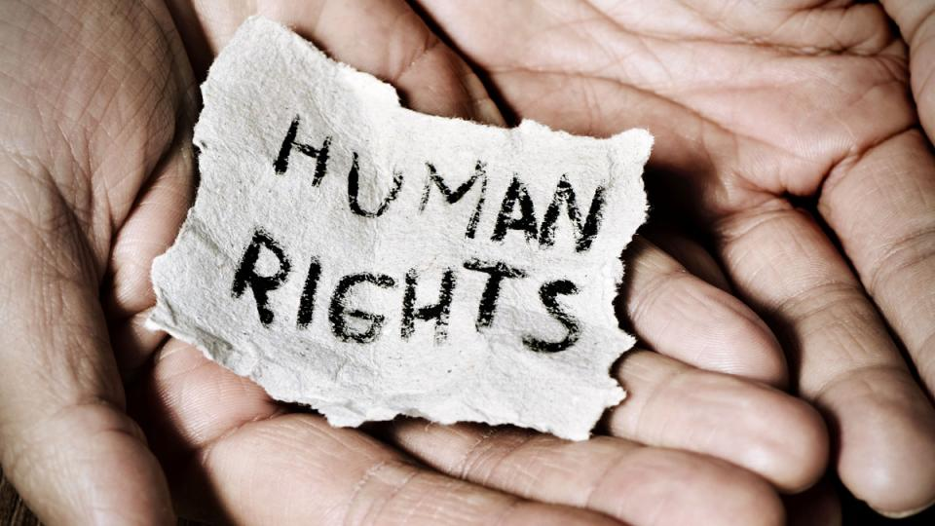
What are Human Rights?
Human rights: a set of principles concerned with equality and fairness.
Every person has dignity and value.
Acknowledging and respecting human rights is a way to recognize the fundamental worth of every person.
Recognize our freedom to make choices about our lives and to develop our potential as human beings.
About living a life free from fear, harassment, or discrimination.
Human rights are the same for all people everywhere. Human rights are UNIVERSAL.

Slide 4
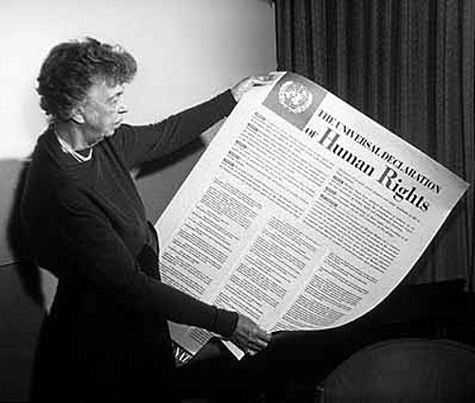
Universal Declaration of Human Rights
“[R]ecognition of the inherent dignity and of the equal and inalienable rights of all members of the human family is the foundation of freedom, justice and peace in the world”
“[D]isregard and contempt for human rights have resulted in barbarous acts which have outraged the conscience of mankind, and the advent of a world in which human beings shall enjoy freedom of speech and belief and freedom from fear and want has been proclaimed as the highest aspiration of the common people”
Protection of human rights by the rule of law “is essential, if man is not to be compelled to have recourse, as a last resort, to rebellion against tyranny and oppression”
“[E]ssential to promote the development of friendly relations between nations”
This Photo by Unknown Author is licensed under CC BY-SA-NC
Notes:
Eleanor Roosevelt's role in creating the UDHR
Appointed by Pres Truman as U.S. delegate to the United Nations in 1945
Elected chair of the UN Commission on Human Rights in 1947
Led the body directly responsible for drafting the UDHR
negotiations among 58 member nations with vastly different political systems and traditions
ideological tensions between Western democracies and the Soviet bloc
differences between nations from Asia, Latin America, the Middle East, and Europe
Pushed for the declaration to be universal — applying to all people, not just citizens of specific states
Insisted on non-discrimination as a foundational principle throughout the document
UDHR adopted by the UN General Assembly on December 10, 1948 – now intl HR day
The UDHR she helped create remains the foundational legal framework referenced in human rights monitoring work to this day

Slide 5
Do not edit How to change the design
What international human rights treaties has the US ratified?
The Slido app must be installed on every computer you’re presenting from

Slide 6
Human rights treaties ratified by the U.S.*
Article VI “This Constitution, and the Laws of the United States which shall be made in Pursuance thereof; and all Treaties made, or which shall be made, under the Authority of the United States, shall be the supreme Law of the Land; and the Judges in every State shall be bound thereby, any Thing in the Constitution or Laws of any State to the Contrary notwithstanding.”
International Covenant on Civil and Political Rights
Convention against Torture and Other Cruel, Inhuman or Degrading Treatment or Punishment
International Convention on the Elimination of all forms of Racial Discrimination
Convention concerning the Prohibition and Immediate Action for the Elimination of the Worst Forms of Child Labour
Abolition of Forced Labour Convention
Protocol amending the Slavery Convention *Relevant to MSE
Notes:
No all treaties (eg genocide convention, refugee convention protocol). Just ones relevant to mega sporting events

Slide 7
International Covenant on Civil and Political Rights
Article VI “This Constitution, and the Laws of the United States which shall be made in Pursuance thereof; and all Treaties made, or which shall be made, under the Authority of the United States, shall be the supreme Law of the Land; and the Judges in every State shall be bound thereby, any Thing in the Constitution or Laws of any State to the Contrary notwithstanding.”
Non-Discrimination & Equality
Article 2 — states must guarantee rights without distinction of race, sex, language, religion, national origin, or other status
Article 26 — equality before the law. Prohibition of discrimination.
Civil & Political Freedoms
Article 19 —freedom of expression
Article 21 —right to peaceful assembly
Article 22 —freedom of association
Liberty & Security
Article 9 — prohibits arbitrary arrest and detention
Article 13 — protects against arbitrary expulsion of foreign nationals
Housing & Forced Evictions
Article 17 — prohibits arbitrary interference with home and family
Vulnerable Groups
Article 23 & 24 — protection of the family and special protections for children
Article 27 — protects the rights of ethnic, religious, and linguistic minorities
Remedies
Article 2(3) — right to an effective remedy for any ICCPR violation
Notes:
-19: protest and journalism — frequently restricted in host countries during major events
-right to peaceful assembly often curtailed through "fan zones" and protest exclusion zones around venues
-freedom of association-right to form and join trade unions
-arbitrary arrest and detention — relevant to crackdowns on protesters, homeless people, and migrants during events

Slide 8
Convention against Torture and Other Cruel, Inhuman or Degrading Treatment or Punishment
Article VI “This Constitution, and the Laws of the United States which shall be made in Pursuance thereof; and all Treaties made, or which shall be made, under the Authority of the United States, shall be the supreme Law of the Land; and the Judges in every State shall be bound thereby, any Thing in the Constitution or Laws of any State to the Contrary notwithstanding.”
Core Prohibition
Art. 1 — “any severe physical or mental suffering inflicted by or with the consent of a public official for purposes such as intimidation, coercion, or discrimination”
Art. 2 —must take effective measures to prevent torture. A non-derogable right.
Non-Refoulement
Art. 3 — prohibits expulsion to a country where there are substantial grounds for believing person would face torture
Investigation & Remedy
Art. 12 —requires prompt & impartial investigation when there are reasonable grounds to believe
Art. 13 —right to have case examined by competent authorities
Art. 14 —redress & fair & adequate compensation
Cruel, Inhuman or Degrading Treatment
Art. 16 — extends state obligations to prevent cruel, inhuman, or degrading treatment even where the threshold for torture is not met
Training & Instruction
Art. 10 — education/information about prohibition of torture must be included in training for law enforcement, military, medical, & other personnel
Art. 11 —systematic review of interrogation rules/ practices
International Cooperation
Art. 9 —states must afford one another maximum assistance in criminal proceedings related to torture
Notes:
Art. 3 —directly relevant to deportation and immigration enforcement actions taken against fans, workers, or asylum seekers during tournaments
Art. 16 —particularly relevant to mega sporting events because many documented abuses such as:
Inhumane labor conditions for construction workers
Forced evictions of homeless populations
Degrading treatment of LGBTQ+ individuals by police
Detention conditions for migrants and protesters
may fall under this broader standard even if they do not constitute torture strictly defined

Slide 9
International Convention on the Elimination of all forms of Racial Discrimination
Article VI “This Constitution, and the Laws of the United States which shall be made in Pursuance thereof; and all Treaties made, or which shall be made, under the Authority of the United States, shall be the supreme Law of the Land; and the Judges in every State shall be bound thereby, any Thing in the Constitution or Laws of any State to the Contrary notwithstanding.”
Core Obligations
Art. 2 —states must pursue a policy of eliminating racial discrimination
Art. 3 — explicitly condemns racial segregation and apartheid
Prohibition of Racial Discrimination
Art. 4 —states must condemn and criminalize racist propaganda, hate speech, and organizations promoting racial superiority
Art. 5 — prohibits racial discrimination in the enjoyment of a wide range of rights including:
Political rights
Freedom of movement
Right to leave and return
Right to housing
Right to public health and medical care
Right to education
Right to access public places and services
Effective Remedies
Art. 6 —effective protection and remedies through national tribunals, including the right to seek just and adequate reparation
Art. 7 —must adopt effective measures in education, culture, and information to combat racial prejudice
Monitoring & Reporting
Art. 11 — establishes an interstate complaint mechanism
Notes:
Art. 2 foundational to any accountability framework for event-related racial abuses involving police, security contractors, or public officials
art. 4 —directly relevant to monitoring racist chanting, banners, and online hate speech by fans during matches, and the obligations of host cities and FIFA to respond
Racial profiling by security forces — Articles 2 and 5(b) together create a strong basis for challenging stop-and-search practices, crowd control tactics, and border enforcement disproportionately targeting fans of color or nationals of certain countries
Migrant worker exploitation — Articles 2 and 5(e)(i) and (ii) are directly applicable to discriminatory labor practices in event construction and hospitality sectors that disproportionately affect workers of color
Housing displacement — Article 5(e)(iii) supports claims by minority and low-income communities of color displaced by stadium construction or event-driven gentrification
Indigenous communities — Articles 2 and 5 together support claims by indigenous communities whose lands, cultures, or resources are adversely affected by event infrastructure development

Slide 10
Convention concerning the Prohibition and Immediate Action for the Elimination of the Worst Forms of Child Labour
Article VI “This Constitution, and the Laws of the United States which shall be made in Pursuance thereof; and all Treaties made, or which shall be made, under the Authority of the United States, shall be the supreme Law of the Land; and the Judges in every State shall be bound thereby, any Thing in the Constitution or Laws of any State to the Contrary notwithstanding.”
Core Prohibition
Art. 1 —immediate & effective measures to secure the prohibition & elimination of worst forms of child labor
Art. 2 —child is any person under 18
Definition of Worst Forms
Art. 3 — slavery; trafficking; debt bondage; forced labor; prostitution or pornography; illicit activities, in particular for the production and trafficking of drugs; work which is likely to harm the health, safety, or morals of children
Programs of Action
Art. 4 —determine and monitor the types of hazardous work prohibited for children
Art. 5 & 6 —establish monitoring mechanisms to implement the convention and develop action plans
Access to Education & Rehabilitation
Art. 7 —
Removal of children from the worst forms of child labor and for their rehabilitation and social integration
Access to free basic education and vocational training for all children removed from the worst forms of child labor
Identify & reach out to children at special risk
Take account of the special situation of girls
International Cooperation
Art. 8 —states must assist one another in giving effect to the convention
Notes:
Article 3 —worst forms of child labor :
trafficking of minors for sexual exploitation and forced labor documented around previous World Cups and Olympics, and explicitly addressed in the toolkit
concerns already raised in the Houston and Dallas human rights commitments
relevant where criminal networks operating around event venues recruit or coerce minors into drug distribution or other criminal activity
event-related child labor including:
Informal vending and hawking
Night work in hospitality and catering
Construction work on event facilities
Domestic service in households of event workers or officials
Agricultural supply chains producing food and merchandise for events
Article 6 —relevant to the obligation of host cities like Dallas and Houston to have specific action plans addressing child labor and trafficking risks associated with the World Cup

Slide 11
Abolition of Forced Labour Convention & Protocol Amending the Slavery Convention
Article VI “This Constitution, and the Laws of the United States which shall be made in Pursuance thereof; and all Treaties made, or which shall be made, under the Authority of the United States, shall be the supreme Law of the Land; and the Judges in every State shall be bound thereby, any Thing in the Constitution or Laws of any State to the Contrary notwithstanding.”
Abolition of Forced Labour Convention (ILO 105)
Art. 1 —every state must suppress and not make use of any form of forced or compulsory labor as a means of:
Political coercion or education, or as punishment for holding or expressing political views or views ideologically opposed to the established political, social, or economic system
Economic development
Labor discipline
Punishment for participation in strikes
Racial, social, national, or religious discrimination
Protocol Amending the Slavery Convention
Core Definitions from 1926 Convention Preserved by the Protocol
Art. 1(1)—slavery: the status or condition of a person over whom any or all of the powers attaching to the right of ownership are exercised
Art. 1(2)—slave trade: all acts involved in the capture, acquisition, or disposal of a person with intent to reduce them to slavery, as well as all acts of acquisition of a slave with a view to selling or exchanging them
Core Obligations from the 1926 Convention as Preserved by the Protocol
Art. 2(a) of the 1926 Convention —states must prevent and suppress the slave trade
Art. 2(b) of the 1926 Convention —states must bring about progressively and as soon as possible the complete abolition of slavery in all its forms
(Protocol must be read together with the original 1926 Slavery Convention whose substantive provisions it preserves and updates)
Notes:
ILO Convention No. 105 -Abolition of Forced Labour
Article 1 —
Economic development —economic development rationale of hosting a World Cup or Olympics has historically been used to justify the mobilization of forced or coerced labor for stadium construction, infrastructure development, and urban renewal projects
Labor discipline —workers in event construction or hospitality sectors face threats, penalties, or coercive measures designed to suppress complaints about wages, conditions, or safety
Punishment for participation in strikes —
Racial, social, national, or religious discrimination —migrant workers from particular countries or ethnic backgrounds are disproportionately subjected to coercive labor practices, as extensively documented in Gulf state World Cup preparations
Supply chain due diligence — while Convention No. 105 does not explicitly address supply chains, its prohibition on forced labor as a means of economic development under Article 1(b) creates a strong basis for requiring event organizers, FIFA, sponsors, and contractors to conduct meaningful due diligence on forced labor risks throughout their supply chains for construction, merchandise, food, uniforms, and other event-related goods and services
Intersection with human trafficking — Articles 1(a) and 1(e) together with the Palermo Protocol create a comprehensive framework for addressing the trafficking of workers into forced labor situations connected to mega sporting events, directly supporting the anti-trafficking commitments made by Houston and Dallas in their World Cup human rights plans

Slide 12
Do not edit How to change the design
Audience Q&A (anonymous, but feel free to include your name)
The Slido app must be installed on every computer you’re presenting from

Slide 13
What does this
have to do with
the FIFA World Cup 2026?*
*and other mega sporting events

Slide 14
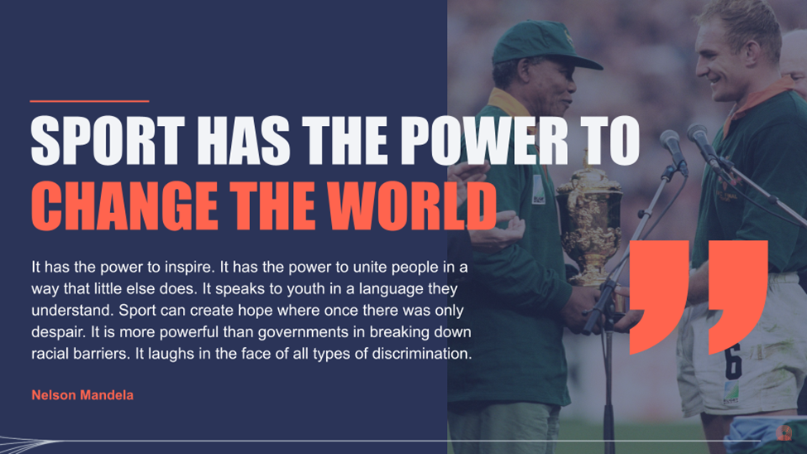
Notes:
Ambitious link between sports and human rights

Slide 15
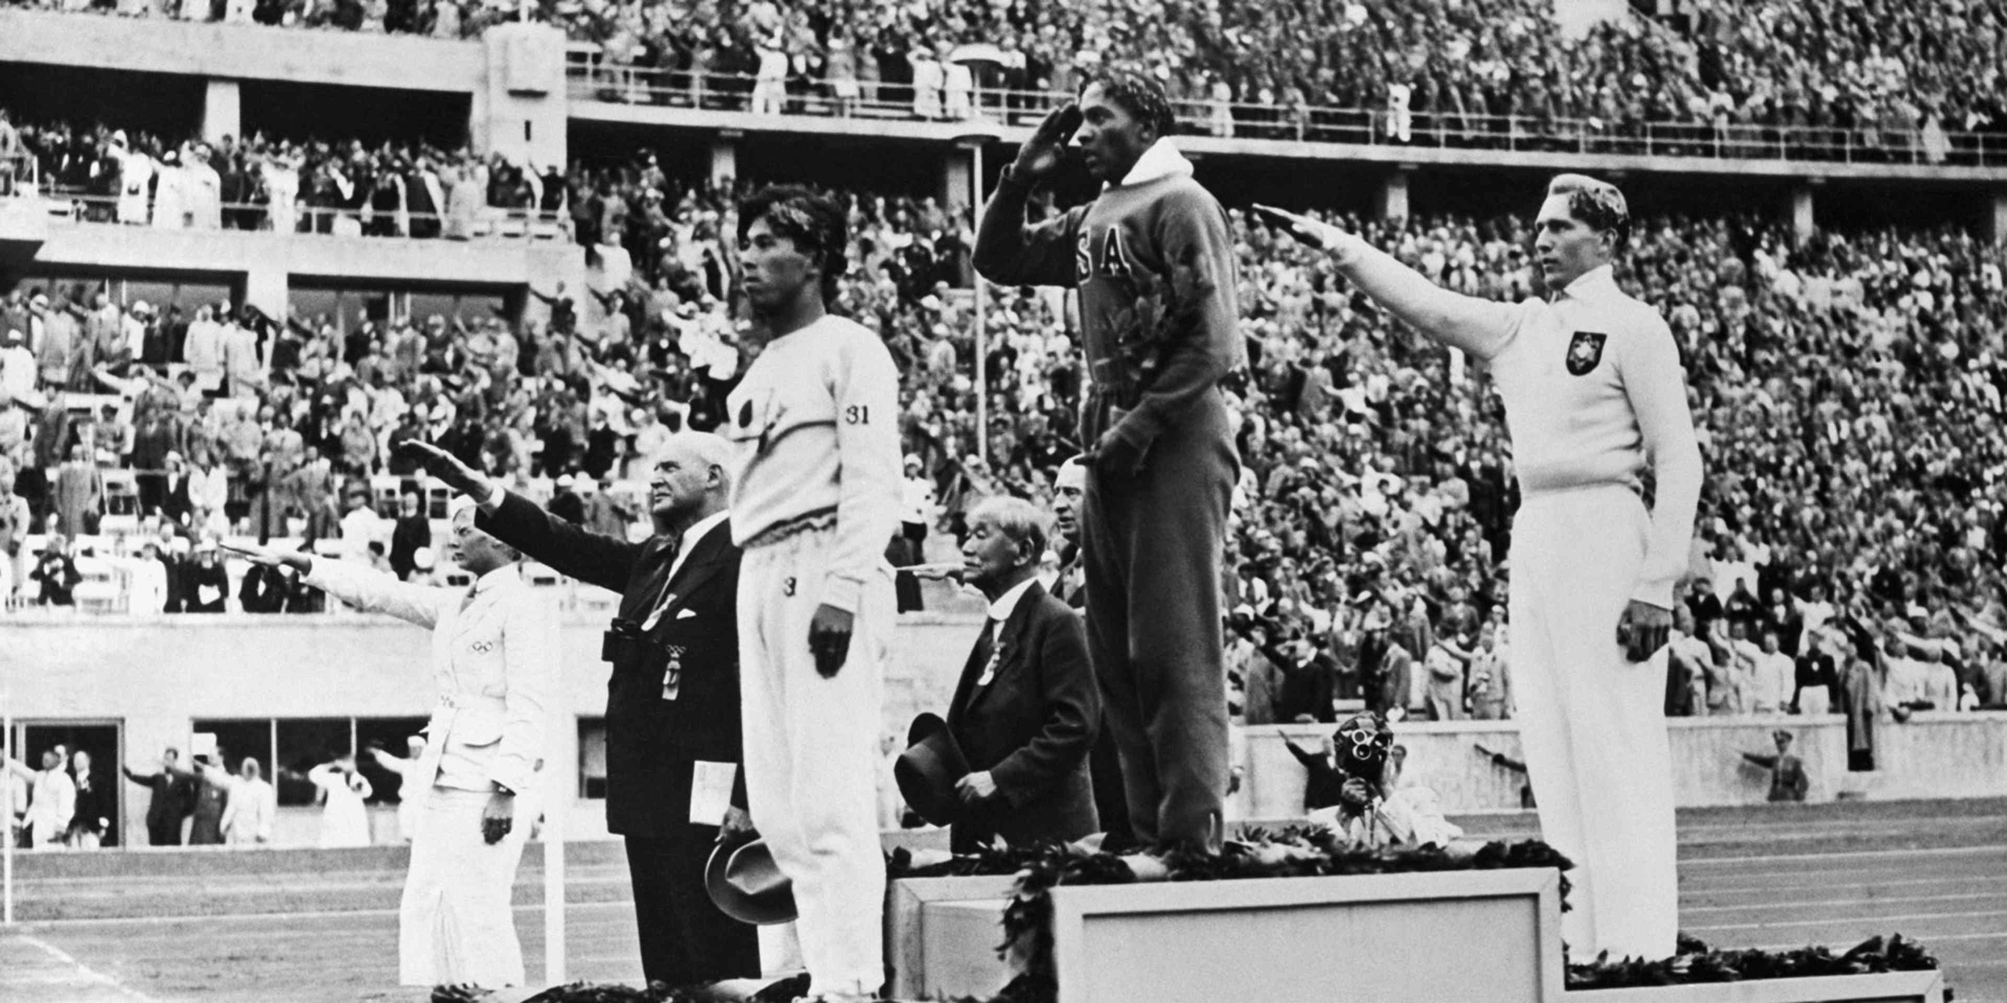
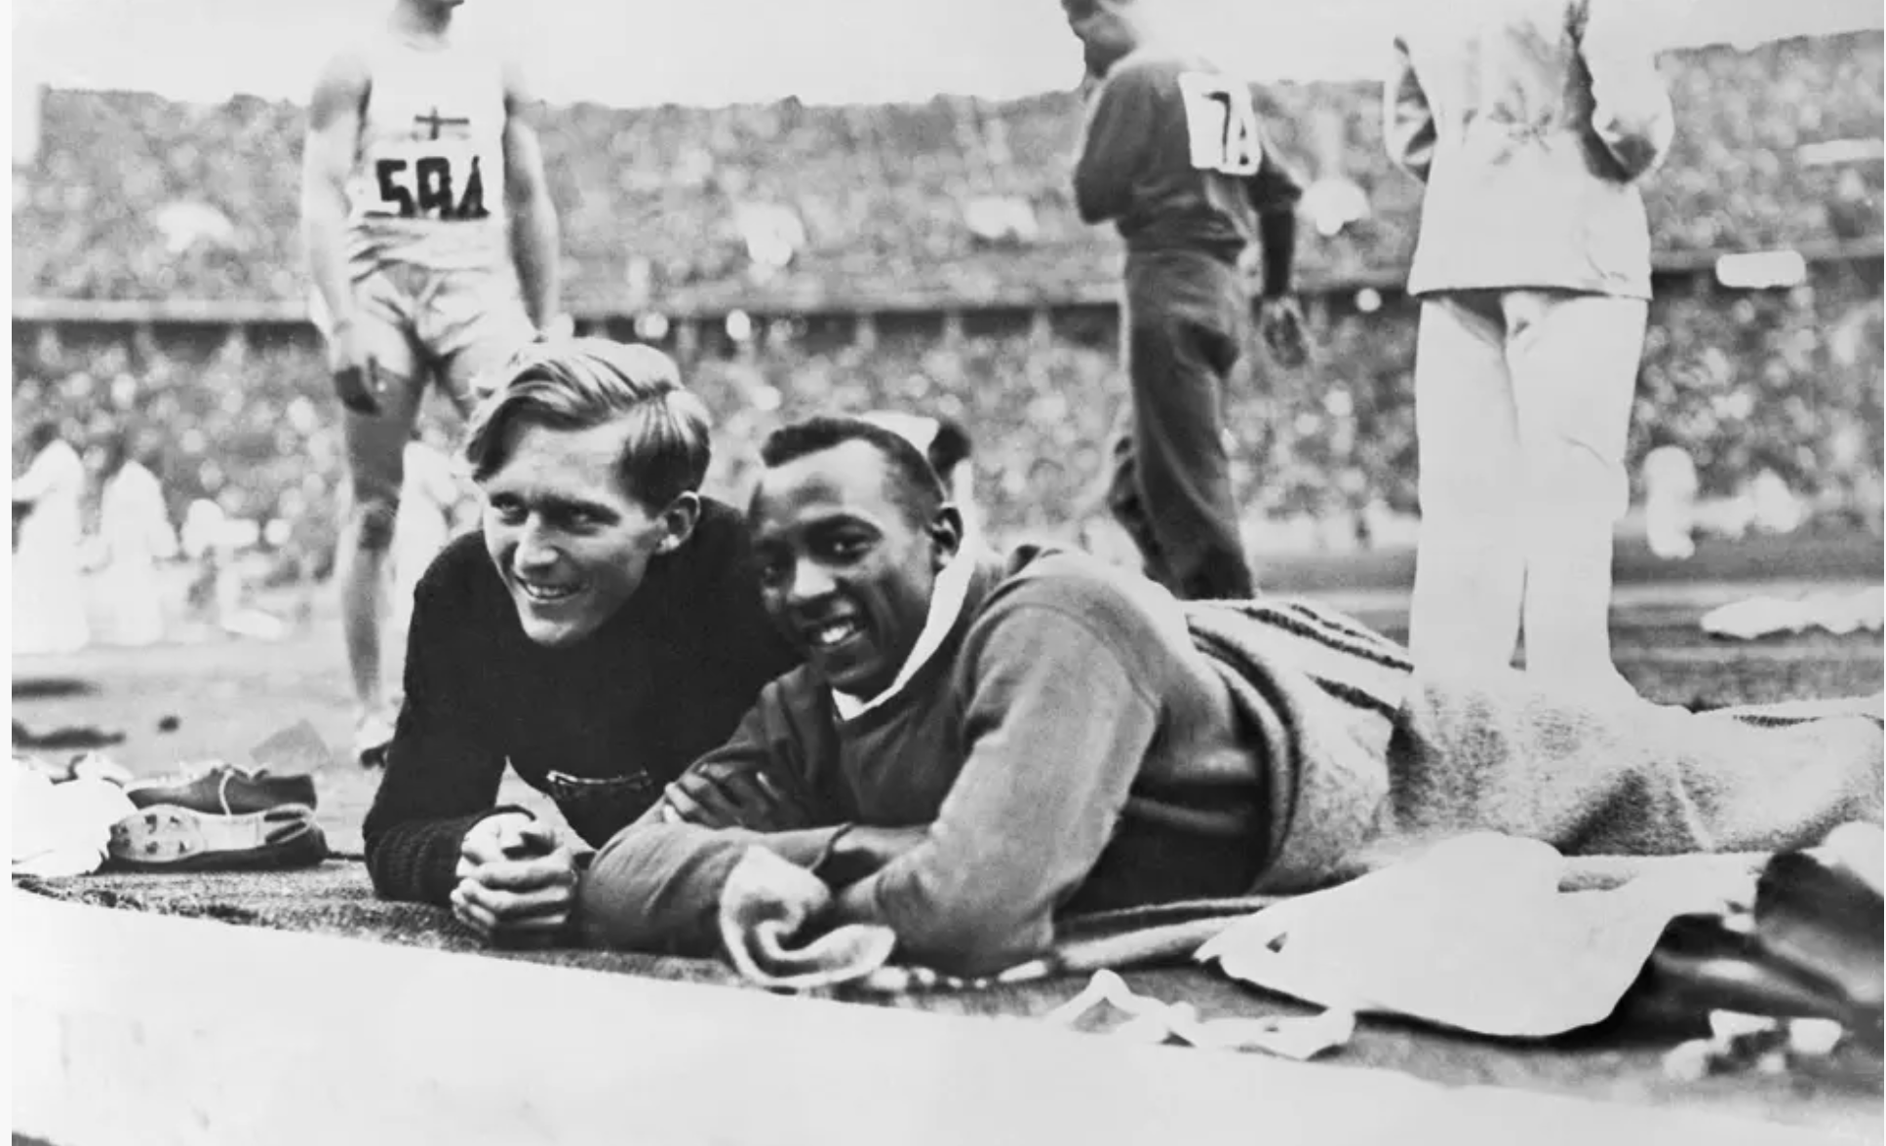
Jesse Owens 1936 Olympics
Four gold medals: 100 meters, long jump, 200 meters, and 4 × 100-meter relay
“[S]ingle-handedly crushed Hitler's myth of Aryan supremacy.” Larry Schwartz, “Owens pierced a myth,” 6 July 2000, https://www.espn.com/sportscentury/features/00016393.html
Notes:
Carl Ludwig "Luz" Long

Slide 16
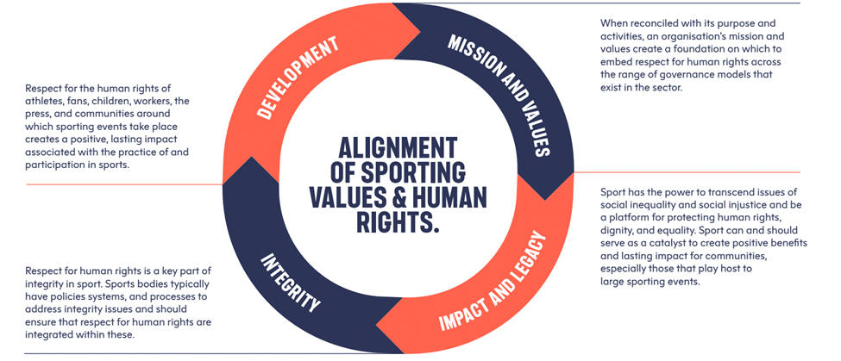
Notes:
Primary schools: use sports to teach human rights values. physical exercise is often an integral part of the education: fair play, equality, non-discrimination can be taught and learned in a playful manner.
secondary education: additional emphasis on the broader human rights risks related to sport, in form of what is expected behaviour, what constitutes harm, how can it be prevented and addressed, and how sport is performed and perceived around the world and in different cultures, including in the MSE context.
FIFA World Cup 2026: 1st MSE to mandate human rights commitments from host countries during the bid process.

Slide 17
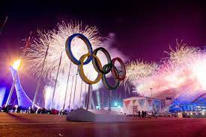
The Olympic Charter: Fundamental Principles of Olympism
1. Olympism is a philosophy of life, exalting and combining in a balanced whole the qualities of body, will and mind. Blending sport with culture and education, Olympism seeks to create a way of life based on the joy of effort, the educational value of good example, social responsibility and respect for internationally recognised human rights and universal fundamental ethical principles within the remit of the Olympic Movement.
2. The goal of Olympism is to place sport at the service of the harmonious development of humankind, with a view to promoting a peaceful society concerned with the preservation of human dignity.
…
4 The practice of sport is a human right. Every individual must have access to the practice of sport, without discrimination of any kind in respect of internationally recognised human rights within the remit of the Olympic Movement. The Olympic spirit requires mutual understanding with a spirit of friendship, solidarity and fair play.
…
6 The enjoyment of the rights and freedoms set forth in this Olympic Charter shall be secured without discrimination of any kind, such as race, colour, sex, sexual orientation, language, religion, political or other opinion, national or social origin, property, birth or other status.
…
Notes:
In spite of all this, there are serious HR risks associated w/MSE

Slide 18
Do not edit How to change the design
What human rights risks are associated with mega sporting events?
The Slido app must be installed on every computer you’re presenting from

Slide 20
FIFA World Cup: Qatar 2022 saw thousands of migrant workers die during stadium construction under conditions of forced labor and wage theft
FIFA World Cup: South Africa 2010 saw authorities conduct mass roundups and forced relocations of homeless people and street vendors ahead of the tournament
FIFA World Cup: Brazil 2014 involved mass forced evictions of poor communities near stadium construction sites, displacing an estimated 250,000 people
Beijing Olympics 2008 involved the forced displacement of an estimated 1.5 million residents to make way for Olympic infrastructure
2016 Copa América in the United States raised concerns about the exploitation of undocumented stadium and hospitality workers with no labor protections
Beijing Olympics 2022 drew condemnation for being hosted amid ongoing documented atrocities against the Uyghur population in Xinjiang
The 1978 FIFA World Cup in Argentina was hosted by a military dictatorship that used the event to distract international attention from its campaign of forced disappearances and torture
Sochi Olympics 2014 saw widespread suppression of LGBTQ+ rights alongside forced evictions and labor abuses during construction
Rio Olympics 2016 involved militarized police operations in favelas that resulted in killings, forced evictions, and the displacement of an estimated 77,000 residents

Slide 21
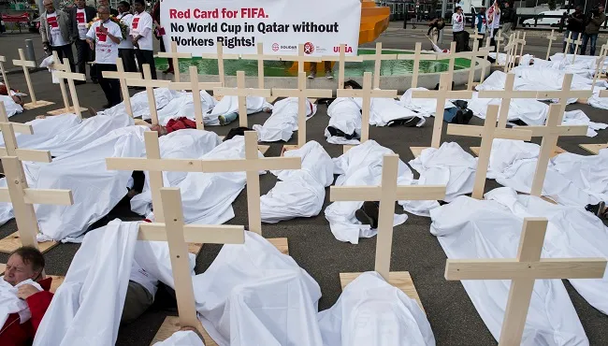
Forced Labor & Modern Slavery in Construction
An estimated 6,500 migrant workers from South Asia died during the construction of stadiums and infrastructure for the Qatar 2022 FIFA World Cup under conditions of extreme heat, unsafe worksites, and near-total employer control.
1926 Slavery Convention/1953 Protocol — Article 1(1): employer control amounting to ownership
ILO Convention No. 105 — Article 1(b): forced labor as a means of economic development
ILO Convention No. 182 — Article 3(a): forced labor of workers under 18
ICCPR — Article 8: prohibition on forced labor and slavery
ICERD — Article 5(e)(i) and (ii): racial discrimination in labor and union rights
CAT — Article 16: cruel and degrading treatment in labor conditions

Slide 22
Employer Sponsorship Systems
Migrant workers in Qatar building World Cup stadiums were legally bound to their employers under the employer sponsorship systems, meaning they could not change jobs, access legal remedies, or leave the country without employer permission, effectively giving employers ownership-like powers over their workers.
1926 Slavery Convention/1953 Protocol — Article 1(1): conditions amounting to slavery
ILO Convention No. 105 — Article 1(c) and (e): labor discipline and discriminatory coercion
ICERD — Article 5(e)(i): equal right to work and free choice of employment
ICCPR — Article 2: non-discrimination in enjoyment of all rights
CAT — Article 16: degrading conditions of employment and accommodation

Slide 23
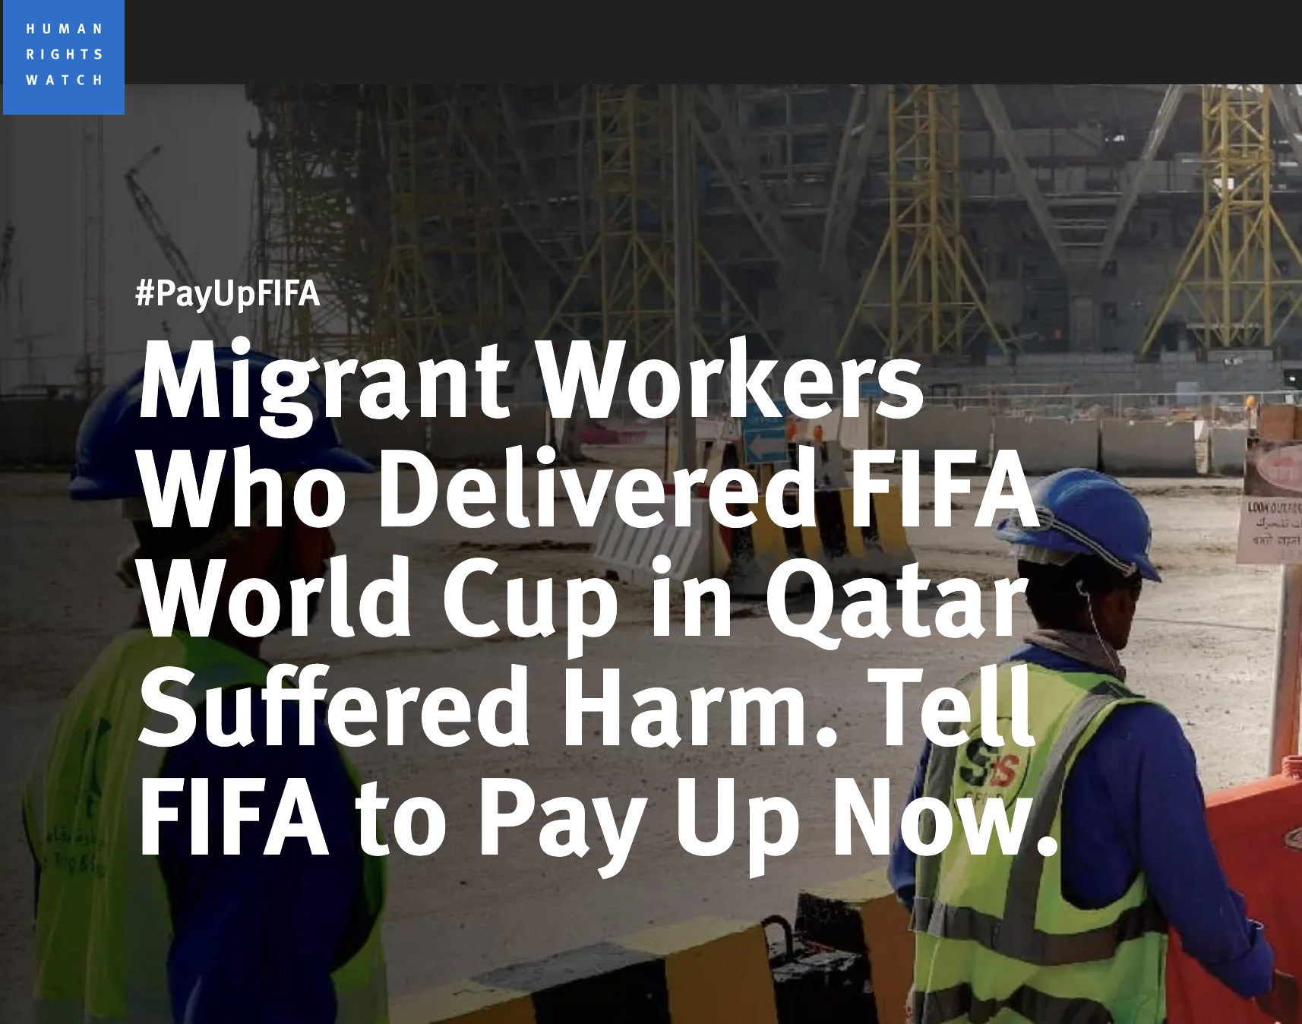
Recruitment Fees and Debt Bondage
Nepalese and Bangladeshi workers recruited to build Qatar 2022 World Cup infrastructure paid brokers fees of up to $4,000 USD to secure employment, creating debt bondage arrangements that trapped them in exploitative conditions they could not afford to leave.
1926 Slavery Convention/1953 Protocol — Article 1(1): debt bondage as a condition of ownership
1956 Supplementary Slavery Convention — directly addresses debt bondage as a slavery-like practice
ILO Convention No. 105 — Article 1(b) and (c): economic coercion and labor discipline
ILO Convention No. 182 — Article 3(a): debt bondage of workers under 18
ICERD — Article 5(e)(i): discriminatory labor recruitment practices
ICCPR — Article 8: prohibition on debt bondage and servitude
Notes:
weak labour laws & limited worked protections > MSE will facilitate labour rights abuses due to the workforce that is usually needed to stage the event.
FIFA’s 2017 Human Rights Policy: existed at time of Qatar games. outlines commitments to uphold internationally recognized labor standards.
Weak enforcement: FIFA failed to implement effective oversight mechanisms
Paris 2024 Olympics: tried to be more ethically conscious than Qatar 2022. yet major labor concerns persisted.
- construction projects employed undocumented migrant workers in unsafe and dangerous conditions. some workers paid below minimum wage, denied social security benefits, and worked excessive hours without proper legal protection.

Slide 24
Child Labor in Event Supply Chains
Global textile & garment industry is one of the highest risk industries for forced and child labour.
Difficult to ensure apparel and merchandise are ethically sourced and not tainted by modern slavery in the early tiers of the supply chain.
Raw materials used for producing garments and merchandise, such as cotton, and the processing and manufacturing of those products are inherently high risk for modern slavery.
Over 80% of China's cotton export is sourced from Xinjiang and there are now extensive and credible reports of significant use of forced labour in the region.
ILO Convention No. 182 — Articles 3(d), 4, and 7: hazardous child labor and supply chain obligations
1926 Slavery Convention/1953 Protocol — Article 1(1): child labor amounting to slavery
ICERD — Article 5(e)(i): discriminatory labor practices affecting children of minority communities
ICCPR — Article 24: special protections for children
CAT — Article 16: degrading conditions of child labor
Notes:
Internationaler Gewerkschaftsbund. World Cup Soccer Balls: Exploitation Still the Norm. (2010). Available from: http://www.ituc-csi.org/world-cup-soccer-balls?lang=de (Accessed January 31, 2017); Brackenridge C, Palmer-Felgate S, Rhind D, Hills L, Kay T, Tiivas A, et al. Child Exploitation and the FIFA world cup: a review of risks and protective interventions (2013) 14. Available from: http://childhub.org/en/system/tdf/library/attachments/1674_Child-Protection-and-the-FIFA-World-Cup-FINAL_original.pdf?file=1&type=node&id=6259
Labour Exploitation: the preparation towards hosting major events and/or the labour demands of such events can lead to instances of children being forced into child labour, particularly in the construction, manufacturing (e.g. supply chain) and hospitality sectors (International Labour Organization, 2017 and 2022).

Slide 25
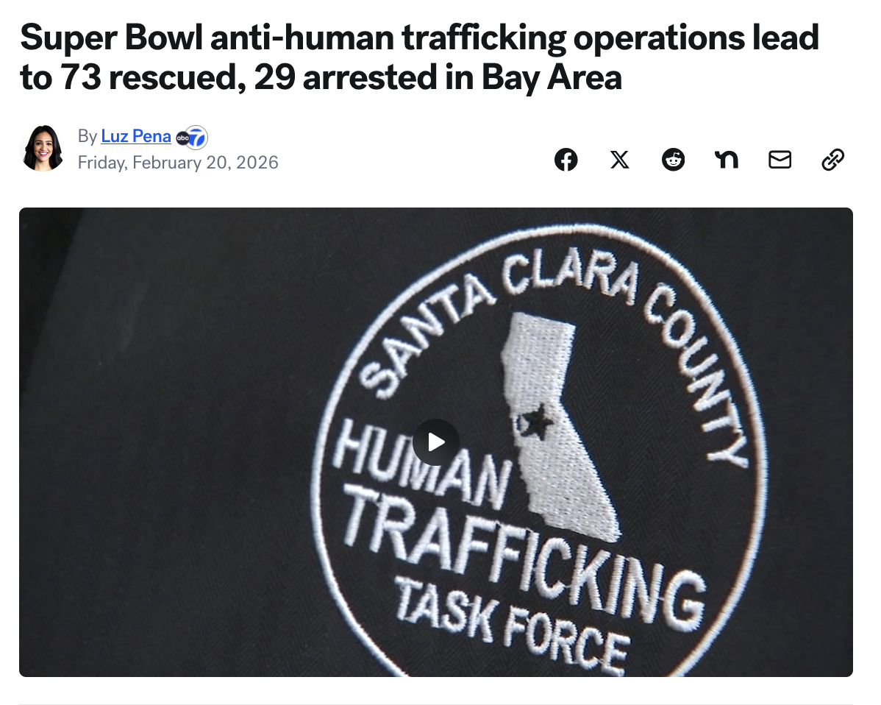
Child Sex Trafficking and Commercial Sexual Exploitation
In the lead-up to the 2026 Super Bowl at Levi's Stadium in Santa Clara, the Santa Clara County District Attorney's Human Trafficking Task Force arrested 29 traffickers and recovered 73 sex trafficking victims, including 10 minors, one of whom was a 12-year-old being trafficked in Oakland.
ILO Convention No. 182 — Article 3(b): use of children for prostitution and pornography
1926 Slavery Convention/1953 Protocol — Art. 1(1) , 2(a): trafficking into sexual slavery
ILO Convention No. 105 — Article 1(a) and (e): coercion and discriminatory exploitation
ICCPR — Articles 8 and 24: prohibition on slavery and special protections for children
CAT — Art. 2, 16: prevention of cruel and degrading treatment of trafficking victims
ICERD — Article 5(b): equal protection against violence for minority and migrant victims

Slide 26
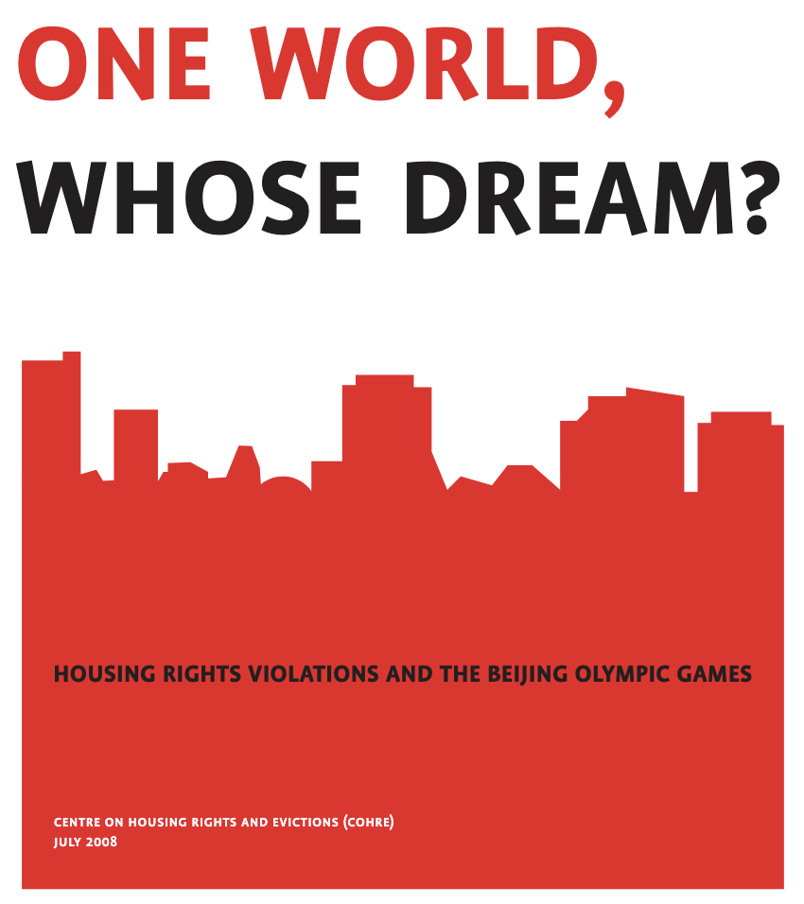
Forced Evictions and Displacement of Communities
An estimated 1.5 million residents of Beijing were displaced from their homes to make way for Olympic venues, infrastructure, and urban beautification projects in the lead-up to the 2008 Summer Olympics.
ICCPR — Article 17: prohibition on arbitrary interference with home
ICERD — Article 5(e)(iii): equal right to housing without racial discrimination
CAT — Article 16: cruel and degrading treatment through forced displacement
ILO Convention No. 105 — Article 1(b): displacement as a means of economic development
ICCPR — Article 26: equal protection against discriminatory displacement policies
Notes:
Study by the Centre on Housing Rights and Evictions: for the Seoul, Barcelona, Atlanta, Sydney, Athens, Beijing, and London events in total around 2 million families and individuals have been displaced or forcefully evicted due to construction projects
Displacements do not automatically lead to human rights abuses, but are illegal if no adequate compensation is secured for the loss of property and even more so if they are carried out forcefully, which unfortunately is often the case if they happen in the context of organizing an MSE (6).

Slide 27
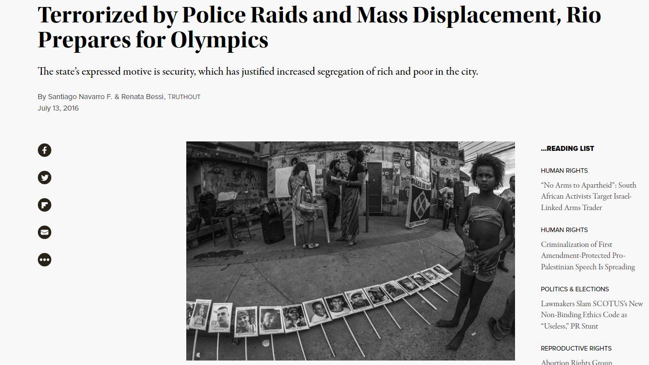
Forced Evictions and Displacement of Communities
Rio 2016: Approx. 77,206 people displaced between 2009 and 2015 as a result of Olympic-related infrastructure projects. Real estate speculation drove property values up dramatically in affected neighborhoods. Police conducted intensified raids in favelas that disproportionately targeted Black youth, with Amnesty International documenting that security policies mirrored those that had already resulted in 2,500 police killings in the city since 2009.
Critics described the preparations as a policy of "social sanitization" — using the Olympics to justify the displacement of poor communities, the criminalization of street vendors, and the militarization of working class neighborhoods, while infrastructure investments benefited wealthy areas at the expense of the poor.
ILO Convention No. 182 — Article 3(b): use of children for prostitution and pornography
1926 Slavery Convention/1953 Protocol — Art. 1(1) , 2(a): trafficking into sexual slavery
ILO Convention No. 105 — Article 1(a) and (e): coercion and discriminatory exploitation
ICCPR — Articles 8 and 24: prohibition on slavery and special protections for children
CAT — Art. 2, 16: prevention of cruel and degrading treatment of trafficking victims
ICERD — Article 5(b): equal protection against violence for minority and migrant victims
Notes:
Atlanta 1996: Approximately 30,000 residents were displaced due to urban redevelopment projects linked to the Games.
Vancouver 2010: Thousands of low-income residents were displaced from the Downtown Eastside as the city ramped up development projects and policing efforts, exacerbating housing insecurity in one of Canada’s most vulnerable communities.
Los Angeles 2028 : Housing Crisis and Gentrification: Los Angeles is already grappling with a severe housing affordability crisis, and Olympic-related developments are expected to exacerbate displacement, particularly for low-income residents. The influx of investment and infrastructure projects may accelerate gentrification, further widening socio-economic disparities.

Slide 28
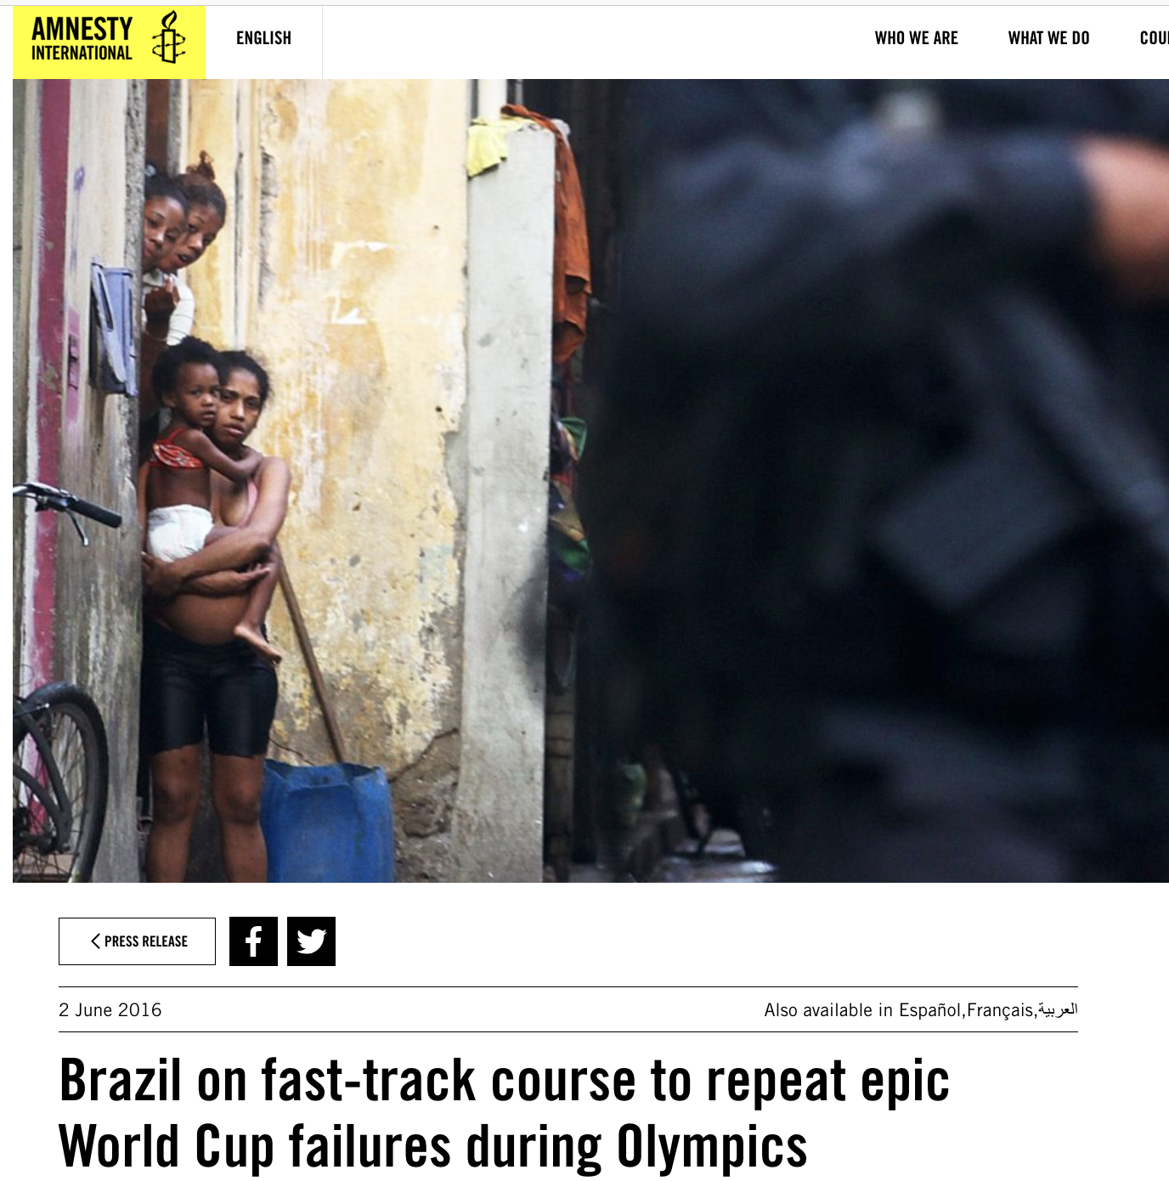
Racial Profiling by Security/Law Enforcement
During the 2014 FIFA World Cup in Brazil, security forces and military police disproportionately stopped, searched, and detained Black and mixed-race Brazilians in and around fan zones and venues in Rio de Janeiro and São Paulo, reflecting longstanding patterns of racially discriminatory policing.
ICERD — Articles 2 and 5(b): prohibition on racial discrimination and equal protection of security
ICCPR — Articles 2, 9, and 26: non-discrimination, prohibition on arbitrary detention, and equal protection
CAT — Articles 2 and 16: prevention of cruel and degrading treatment by security forces
ILO Convention No. 105 — Article 1(e): racially discriminatory coercion by public authorities
Notes:
Increased deployed security personnel > increased readiness to use violence.
2016 Olympics in Rio: killings of in particular young black males living in favelas in the context of the police pacification campaigns increased (11). Amnesty International reported that in the months leading up to the event, violence and police killings increased every month (12). In South Africa, some regions showed an almost 50% increase in fatal shootings by the police in the two years leading up to the World Cup (13).

Slide 29
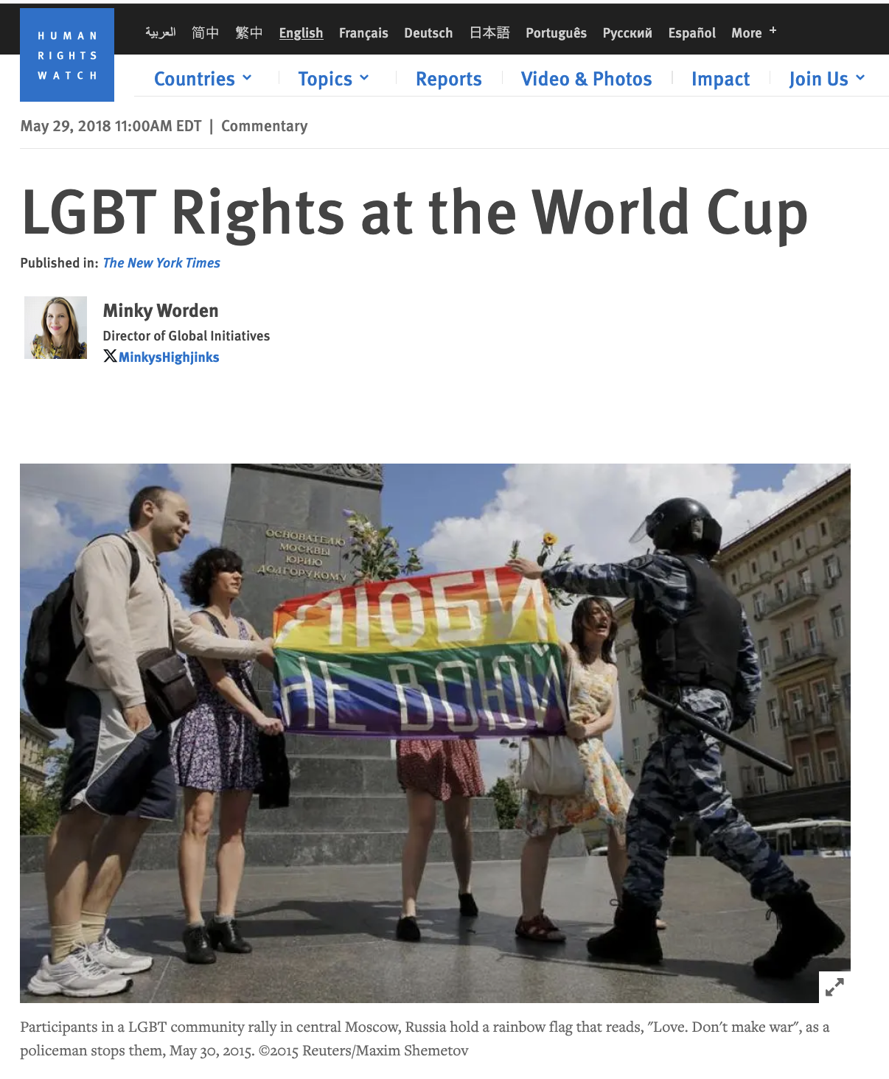
Discrimination Against LGBTQ+ Fans, Workers, and Athletes
Russia's anti-gay propaganda law — which penalizes ”LGBT advocacy” and created a dangerous climate of stigma and violence — remained in force during the 2018 World Cup, with anti-gay violence increasing so much that FARE, an organization that works to counter discrimination in soccer, warned fans attending the World Cup with their same-sex partners not to hold hands in public.
ICCPR — Articles 2, 17, and 26: non-discrimination, privacy, and equal protection
ICERD — Article 5: equal enjoyment of all rights, broadly interpreted to include sexual orientation and gender identity discrimination
CAT — Articles 2 and 16: prevention of cruel and degrading treatment of LGBTQ+ persons by police and security forces
ILO Convention No. 105 — Article 1(e): discriminatory coercion on social grounds

Slide 30
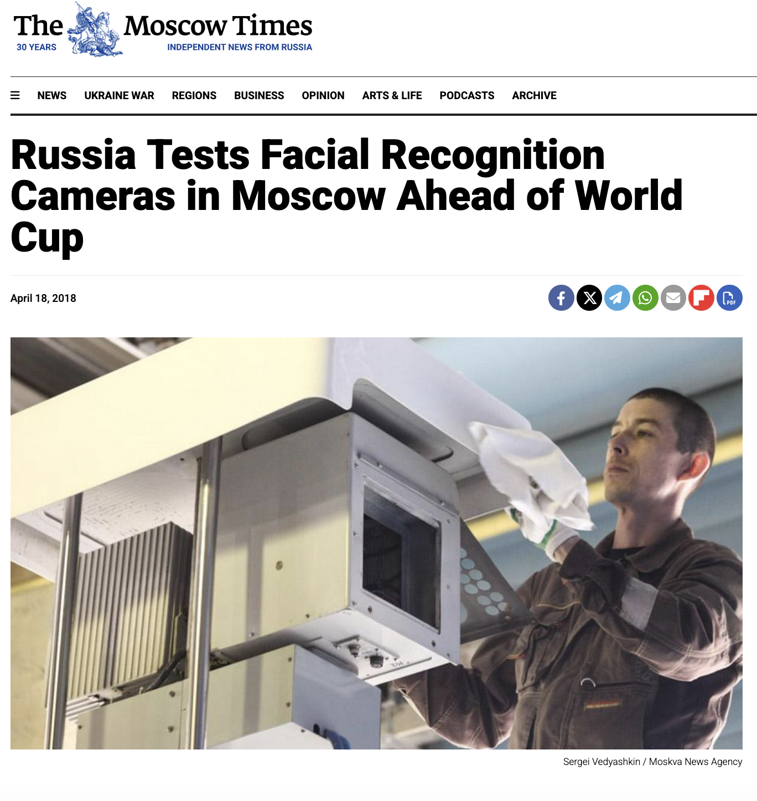
Abuse of surveillance technology
Russia 2018 FIFA World Cup
Deployment of facial rec cameras in Moscow metro and at train stations near World Cup venues: around 160,000.
The cameras could identifying 20 faces per second, with pilot tests at a major Moscow airport reporting a 90% accuracy rate.
ICCPR
Art. 17 — Protection against arbitrary or unlawful interference with privacy
Art. 12 — Liberty of movement and freedom to choose residence
Art. 19 — Freedom of expression
Art. 21 — Right of peaceful assembly
Art. 26 — Equal protection of the law without discrimination (algorithmic bias)
ICERD
Art. 5(b) — Right to security of person and protection against violence, without racial discrimination
Art. 5(d)(i) — Freedom of movement without discrimination
Art. 2 — Obligation to prohibit and eliminate racial discrimination in all its forms (facial recognition systems are documented to have higher error rates for people of color)
Notes:
Mass surveillance without consent or transparency
Risk of wrongful detention due to false positives
Chilling effect on free movement and assembly
Disproportionate impact on migrants, dissidents, and marginalized groups
Normalization of biometric surveillance infrastructure that persists after the event ends
2026 World Cup toolkit's sections on Immigration & Asylum, Participation in Public Affairs, and Hate Crimes, where unchecked surveillance technology can enable profiling and suppress the exercise of rights.
Salt Lake City 2002: Security measures led to increased restrictions on protests and enhanced surveillance, setting a precedent for potential civil liberties challenges in LA 2028.
Paris 2024 Olympics: introduced AI-powered surveillance, sparking fears of government overreach and excessive monitoring of marginalized communities. I

Slide 31
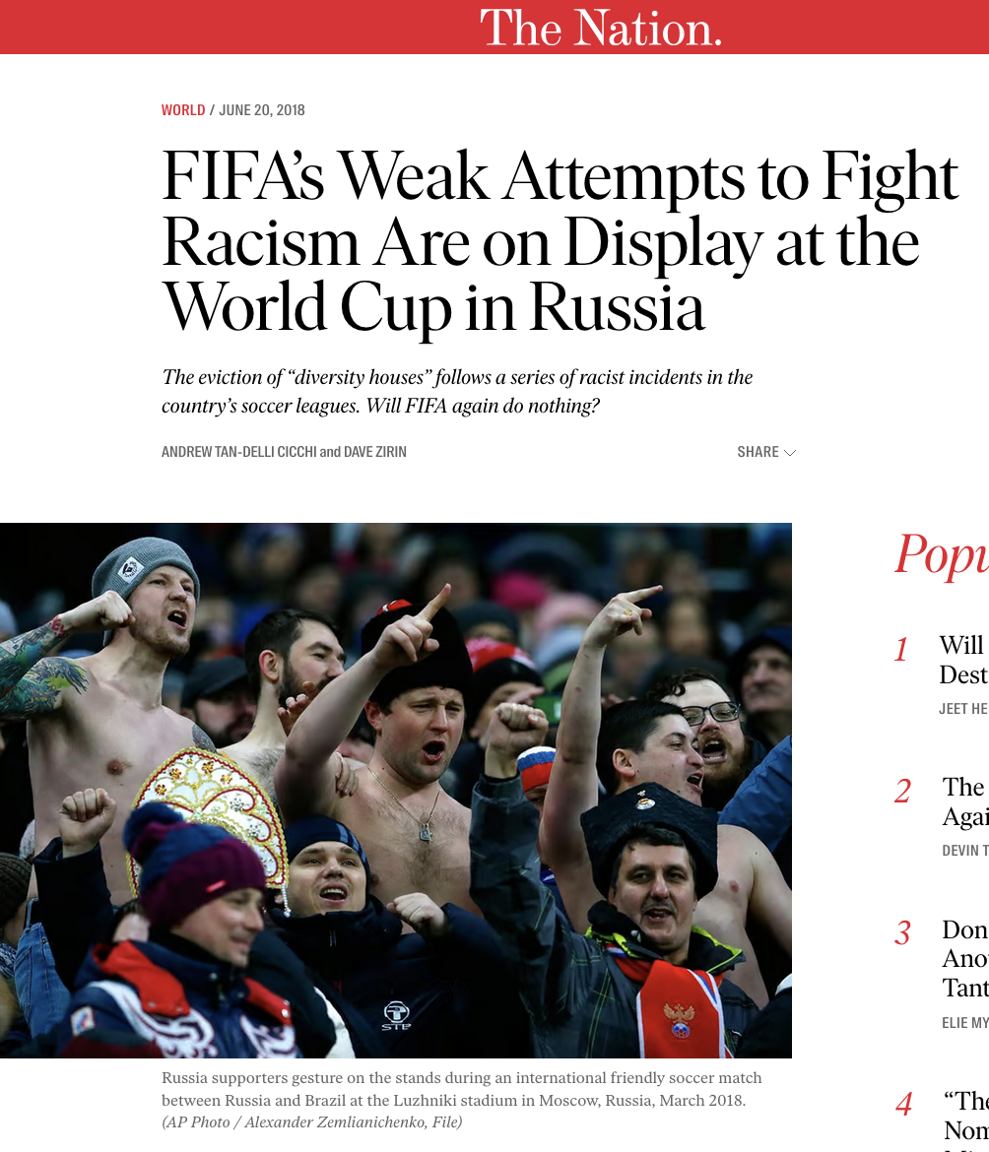
Racist Chanting and Fan Behavior at Venues
Fans at a France vs. Russia friendly in St. Petersburg directed monkey chants at Black French players including on March 27, 2018, just months before Russia hosted the World Cup — prompting FIFA to open disciplinary proceedings against the Russian Football Union. RFU fined only $22,000.
The antiracism group Kick It Out said FIFA's "lack of effective action will likely result in the further abuse of Black players in matches involving Russia" and stated it had "little confidence that FIFA can effectively deal with potential incidents of racism during this summer’s [2018] World Cup."
ICERD — Article 4: obligation to condemn and criminalize racist propaganda and organizations promoting racial superiority
ICCPR — Article 20(2): prohibition on advocacy of national, racial, or religious hatred constituting incitement to discrimination or violence
ICERD — Article 2: obligation to ensure public authorities including police and event security respond effectively to racist incidents
CAT — Article 16: state responsibility for failing to prevent degrading treatment by non-state actors

Slide 32
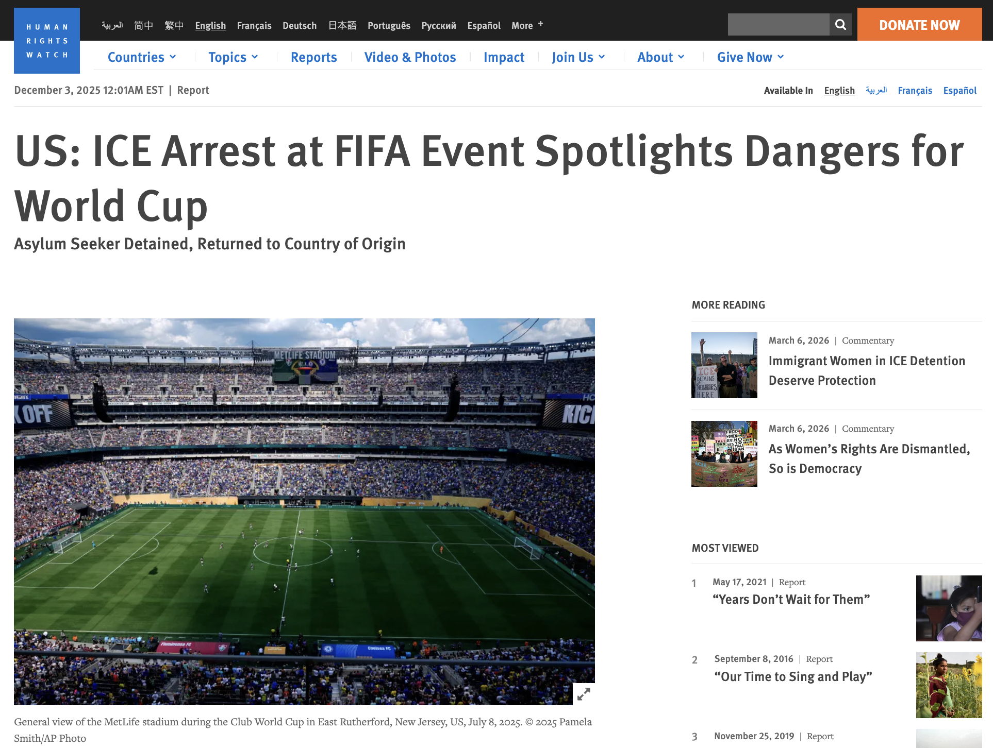
Immigration Enforcement and Deportation
HRW: arrest & deportation of asylum seeker who took his children to the Club World Cup final on July 13, 2025. -> serious concerns about safety of noncitizens attending 2026 World Cup.
Jan. 20-Oct. 15, 2025: ICE arrested at least 92,392 people in & around cities where World Cup games will be played. 65.1% with no criminal convictions.
A coalition including Human Rights Watch, Amnesty International, the ACLU, the NAACP, and the AFL-CIO called on FIFA to secure public commitments to refrain from immigration enforcement operations at all World Cup events and venues, warning that U.S. visa bans and mass deportation raids were keeping immigrants, workers, journalists, communities, and fans away from the tournament.
ICCPR 9 : prohibition on arbitrary detention, protection against arbitrary expulsion
ICCPR 13: “An alien lawfully in the territory of a State Party to the present Covenant may be expelled therefrom only in pursuance of a decision reached in accordance with law and shall, except where compelling reasons of national security otherwise require, be allowed to submit the reasons against his expulsion and to have his case reviewed by, and be represented for the purpose before, the competent authority or a person or persons especially designated by the competent authority.
ICERD 2 & 5(d)(i) and (ii): racial discrimination in enforcement of movement and travel rights
CAT 3: prohibition on return of any person to a country where they face a substantial risk of torture
ILO 105, 1(e): nationally and racially discriminatory enforcement measures
Notes:
ICCPR Art. 13 protects against arbitrary expulsion of foreign nationals — directly relevant to immigration enforcement during tournaments
Acting ICE director Todd Lyons told lawmakers that the agency would be "a key part of the overall security apparatus" for the tournament and declined to rule out enforcement operations around matches during a Congressional hearing in February 2026, prompting House Democrats to introduce a package of bills aimed at limiting ICE's role during the World Cup.

Slide 33
And more…
Suppression of Worker Organizing & Strikes Migrant construction workers building stadiums for the Qatar 2022 FIFA World Cup who attempted to organize or strike over unpaid wages & unsafe conditions faced immediate dismissal, deportation, blacklisting from future employment in Gulf region.
Violence & Hate Crimes Against Minority Fans During Euro 2020, 3 Black England players subjected to torrent of racially abusive messages & threats following England's penalty shootout defeat. Hate crime reports in England spiked in the days following the final.
Suppression of Freedom of Expression & Press Freedom Journalists & civil society representatives seeking to document labor abuses & forced evictions connected to Qatar 2022 World Cup construction reported systematic harassment, visa denials, confiscation of equipment, and expulsion from the country by Qatari authorities seeking to limit critical international coverage of tournament preparations.
Displacement & Exclusion of Indigenous Communities Construction of Olympic venues & infrastructure for 2010 Vancouver Winter games encroached on territories of several indigenous groups without meaningful consultation or consent, generating protests from indigenous communities despite the games' formal Indigenous partnership program.
Exclusion from Participation in Event Planning and Governance Communities in Rio de Janeiro's favelas that were directly affected by forced evictions and infrastructure development for the 2016 Olympics reported having no meaningful opportunity to participate in planning decisions, with city authorities conducting only perfunctory consultations that civil society organizations described as designed to legitimize predetermined outcomes rather than genuinely incorporate community input.
Inadequate Remedy and Accountability Mechanisms Migrant workers who suffered wage theft, workplace injuries, and other abuses during Qatar 2022 World Cup construction found that existing labor complaint mechanisms were effectively inaccessible due to language barriers, fear of employer retaliation under the kafala system, prohibitive legal costs, and the absence of any independent oversight body with meaningful enforcement powers.
Notes:
In China, ahead of the Beijing 2008 Olympics, journalists faced tight government controls, with foreign media subjected to surveillance and restricted access. Similarly, at Qatar 2022, international reporters faced harassment and detainment for attempting to document labor conditions and human rights abuses.
Environmental impacts

Slide 34
Do not edit How to change the design
Questions? (Anonymous, but feel free to add your name)
The Slido app must be installed on every computer you’re presenting from

Slide 35
Responsibilities under int’l human rights law
Two sets of responsibilities:
Individual
State

Slide 36
Individual Responsibility
Human rights involve responsibility and duties towards other people and the community.
One person’s ability to enjoy their human rights depends on other people respecting those rights.
Individuals have a responsibility to ensure that they exercise their rights with consideration for the rights of others.
Notes:
Included in here is the notion of corporate responsibility, which the next speaker will cover

Slide 37
Do not edit How to change the design
What are the three obligations of states with respect to international human rights law?
The Slido app must be installed on every computer you’re presenting from

Slide 38
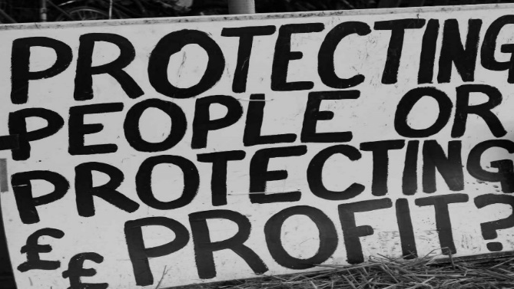
State Responsibility
Under international human rights law, States have the primary responsibility to respect, protect, and fulfill human rights.
Respect: refrain from interfering with or curtailing the enjoyment of human rights.
Protect: protect individuals and groups against human rights abuses.
Fulfill: positive action to facilitate the enjoyment of basic human rights.

Slide 39
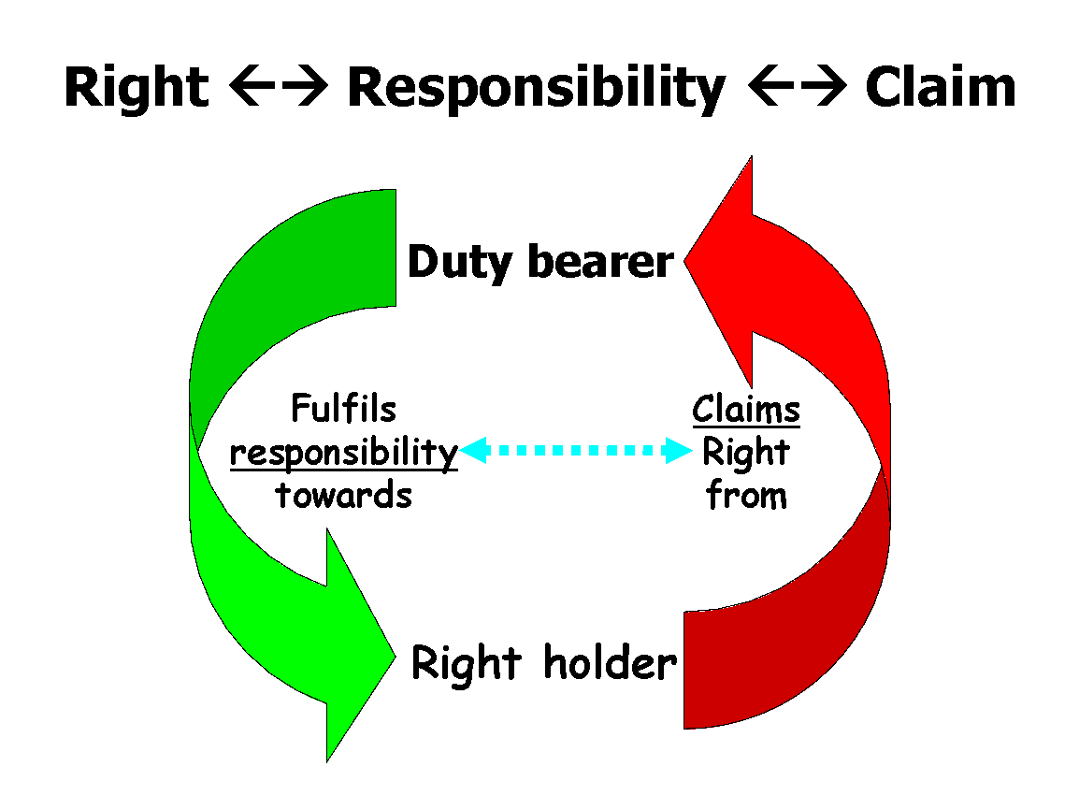
Accountability (Remedies?)

Slide 40
Notes:
Accountability challenge: highly complex operations, jointly staged by mix of national, intl, public, and private actors and organized based on a complex framework of contracts and agreements between all those actors.
planning stage of 2012 London Games: around 2,200 contracts signed
International Sports Governing Bodies (ISGBs) formally “own” these events, also state actors in form of hosting authorities from different levels of government, from central to municipal, as well as (multinational) sponsors, agencies, broadcasters and companies are involved (15). All these actors linked to each other
Problem of many hands: “due to the complexity of the situation and the number of actors involved, it is impossible or at least very difficult to hold someone reasonably responsible”
can facilitate blame-shifting between the different actors and even lead to a number of actors escaping their responsibility entirely.
multi-jurisdictional nature of these events>different laws and standards apply
FIFA’s human rights requirements for the 2026 World Cup include a Human Rights Strategy, but concerns remain over whether these commitments will be meaningfully enforced.

Slide 41
Accountability at the international level
Treaty Bodies
ICCPR, CAT, CERD have monitoring committees to which states submit compliance reports. Issue "concluding observations" identifying violations & recommending reforms
Individual complaints mechanisms where states accept jurisdiction
Relevant to MSE: CSOs, affected communities can submit "shadow reports" to challenge host government narratives
Special Procedures
Independent experts (Special Rapporteurs, Working Groups) monitor specific rights or country situations
Can conduct country visits, issue urgent appeals, and publish public reports
Relevant MSE mandates: Special Rapporteurs on adequate housing, contemporary forms of slavery, freedom of expression
Not binding; reputational pressure; public record
Regional Systems
Inter-American Commission & Court of Human Rights
Individuals & NGOs can petition Commission directly when domestic remedies exhausted
Commission has addressed US cases where domestic courts provided no remedy (e.g., Castle Rock v. Gonzales)
International Criminal Court
ICC jurisdiction limited to genocide, crimes against humanity, war crimes — high threshold rarely met in MSE context
But relevant where MSE hosting enables or conceals atrocity (Beijing 2022 / Xinjiang -> CaH)
Key Limitations
No binding enforcement mechanism
States must consent to jurisdiction; US has not accepted individual petition mechanisms
Remedy is slow, political, and depends on state cooperation
Gap
No international mechanism with direct jurisdiction over FIFA, IOC, or corporate sponsors as non-state actors
Notes:
This is all STATE/STATE ACTOR accountability
It's political
Town of Castle Rock v. Gonzales (2005)
Gonzales's estranged husband kidnapped and murdered their three daughters after police refused to enforce her restraining order
Supreme Court ruled 7–2 that government has no constitutional duty to protect individuals from private harm — leaving her with no domestic remedy
Gonzales took her case to the Inter-American Commission on Human Rights, which in 2011 found the US had violated its international obligations by failing to protect her family from domestic violence

Slide 42
Do not edit How to change the design
Questions? (Anonymous, but feel free to add your name)
The Slido app must be installed on every computer you’re presenting from

Slide 43
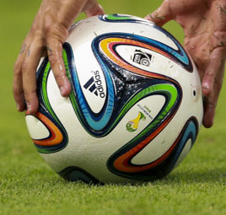
Conclusion
The US has ratified key treaties (ICCPR, CAT, ICERD, ILO conventions) that create binding legal obligations
including during the 2026 FIFA World Cup
Mega sporting events amplify existing human rights risks:
forced labor, displacement, trafficking, discrimination, and suppression of expression
States must respect, protect, and fulfill human rights
silence and inaction are not neutral
Accountability mechanisms exist — domestically, regionally (Inter-American system), and internationally
but gaps remain, particularly for non-state actors like FIFA
Lawyers have a role:
monitoring, advocacy, litigation, and pro bono support can turn commitments into real protections
The 2026 World Cup in Dallas and Houston is not just a sporting event — it is an opportunity and a test
"Sport has the power to change the world." — Nelson Mandela.
So do lawyers.
Notes:
Texas Monthly: The Taliban Targeted Them. FIFA Saved Them. Houston Welcomed Them. Then They Were Left Behind. A group of Afghan women soccer players were rescued from their home country and promised new lives in Texas. They’ve been on their own since.

Slide 44
Do not edit How to change the design
Questions? Final comments?
The Slido app must be installed on every computer you’re presenting from

Slide 45
Thank you!
To learn more about the State Bar of Texas International Law Section’s International Human Rights Committee (IHRC), visit: ilstexas.org/human-rights-committee

